Slide 1
Security that moves with your business
Firstname Lastname Job title

Slide 2

Every business is racing to manage cybersecurity risk.
Notes:
<Presenter: Sets the tone with audience that security teams are likely moving as quickly as they can to protect whatever is changing within their environments.>
It doesn’t matter who you are - be it a multi-national corporation, to a start-up in stealth mode, ultimately everyone’s cybersecurity strategy is racing to manage and mitigate risk.
And this is the reality of executing that today - talented people, across the globe, with hands on keyboards, doing their best.
But this race isn’t just impacting Security practitioners, it permeates across teams, up to the board level, and even to the fabric of our society and economic prosperity.
And with the weight of all of that on their shoulders, IBM recognise that this is a really tough challenge for both the organisation, and the highly skilled individuals in the hot seat.
So we have a duty to make these Security practitioners even more effective, and I’ll explain specifically how we’re doing that.
But first let’s take a look at some of the major factors affecting businesses approach to cybersecurity today.

Slide 3

Key cybersecurity priorities impacting the business
The security landscape
Rapid cloud adoption brings new business risk
82% of breaches in 2022 involved data in the cloud, 39% spanned multiple cloud enviornments¹
Destructive attacks operate with more speed
The time to execute ransomware attacks has dropped 94% over last few years, as seen by X-Force²
New AI-powered defenses save time and money
Early AI adopters are reducing their total cybersecurity costs by 15% and data breach costs by at least 18%³
Shift from point security products to platforms
75% of organizations are pursuing security vendor consolidation according to a recent Gartner study⁴
Notes:
Moving fast is a challenge given today’s business impacts where…
Rapid cloud adoption brings new business risk
Data is Proliferating with relatively little oversight across Cloud & SaaS data stores and Security teams simply can’t keep up
Destructive attacks operate with more speed
Ransomware has become commoditised, leading to far shorter time to exploit – now averaging just three days
New AI-powered defenses save time and money
Companies that have extensive use of AI & Automation in their Security operations saved $1.76m on their costs of a data breach
Shift from point security products to platforms
Disparate and fragmented defensive tools are causing dangerous inefficiencies, and organisations are shifting towards consolidated and open platforms
It’s our job to help clients go faster on this
IBM Security can help…
Sources: ¹IBM Cost of a Data Breach Report 2023: https://www.ibm.biz/breach-report
²IBM X-Force Threat Intelligence Index 2023: https://www.ibm.com/reports/threat-intelligence
³IBM Institute for Business Value: AI and automation for cybersecurity: https://ibm.seismic.com/Link/Content/DC67V7mTdHRf78W2fdP4Bc6TX4cd
⁴2022 Gartner’s CISO: Security Vendor Consolidation Study: https://ibm.enterprise.slack.com/files/W4XMT30HX/F05GX7CFU2F/top_5_trends_in_security_vendor_consolidation.pdf

Slide 4



Secure hybrid cloud and mission critical data
IBM Security strategy
Execute a cybersecurity strategy and roadmap
Activate a zero-trust security strategy and roadmap that aligns to major business initiatives and helps reduce risk
Predict, prevent, and respond to modern threats
Integrate SOC intelligence, AI, and automation to constantly manage exposures, eliminate threats, and stop ransomware
Centralize data security and compliance
Unify data discovery and protection across hybrid cloud to accelerate compliance and defend business reputations
Authenticate users and manage employee devices
Use risk-based, frictionless controls to proactively protect users, apps, and devices in the cloud and on-premises
Accelerate security with an open architecture, AI and intelligence
Integrate existing security tools and save time with a hybrid cloud platform powered by AI, global intelligence, and open integrations
Notes:
<Presenter: This is our point of view slide to help articulate how relevant we are to their future success> This is our blueprint for success, built to secure hybrid cloud and mission critical data.
Any good strategy starts with a plan - we can help clients create their own roadmap of where they are, where they want to be, and how to get there
Using the latest principles in Security, and justifying the investment by quantifying their risk exposure in financial terms
Below that, is the core of what our technology delivers - three pillars of Security that are essential:
Businesses need a Radar to proactively discover threat actors getting into their businesses
They need a Guardian, to protect their Crown Jewels – whether that’s intellectual property, or sensitive client data
They need a Verifier, to let the right people into their business, while minimising friction
Our goal is to provide clients with a strategy that’s holistic and enduring in the long term, with technologies & services aligned to accelerate their adoption
The foundation of our blueprint is our differentiation - an open architecture, powered by AI & Threat intelligence

Slide 5

Open and integrated security software and services
IBM Security portfolio
Execute a cybersecurity strategy and roadmap
Cybersecurity strategy and advisory services Garage for Cybersecurity (co-creation)
IBM Consulting and Ecosystem Partners
Strategy, experience, technology, and managed services
Predict, prevent, and respond to modern threats
Threat Detection and Response
QRadar
Randori
Centralize data security and compliance
Data Security
Guardium
Authenticate users and manage employee devices
Identity, Fraud & Device Management
Verify
Trusteer
MaaS360
zSecure
Accelerate security with an open architecture, AI and intelligence
Cloud Pak for Security X-Force
Notes:
<Presenter: Show how the portfolio comes together, this is a perfect tool to identify opportunities and use as your jumping off point into desired area of focus -- “chapters” in bold are clickable in slide show mode> Our blueprint strategy aligns to our open and integrated software and services portfolio…

Slide 6

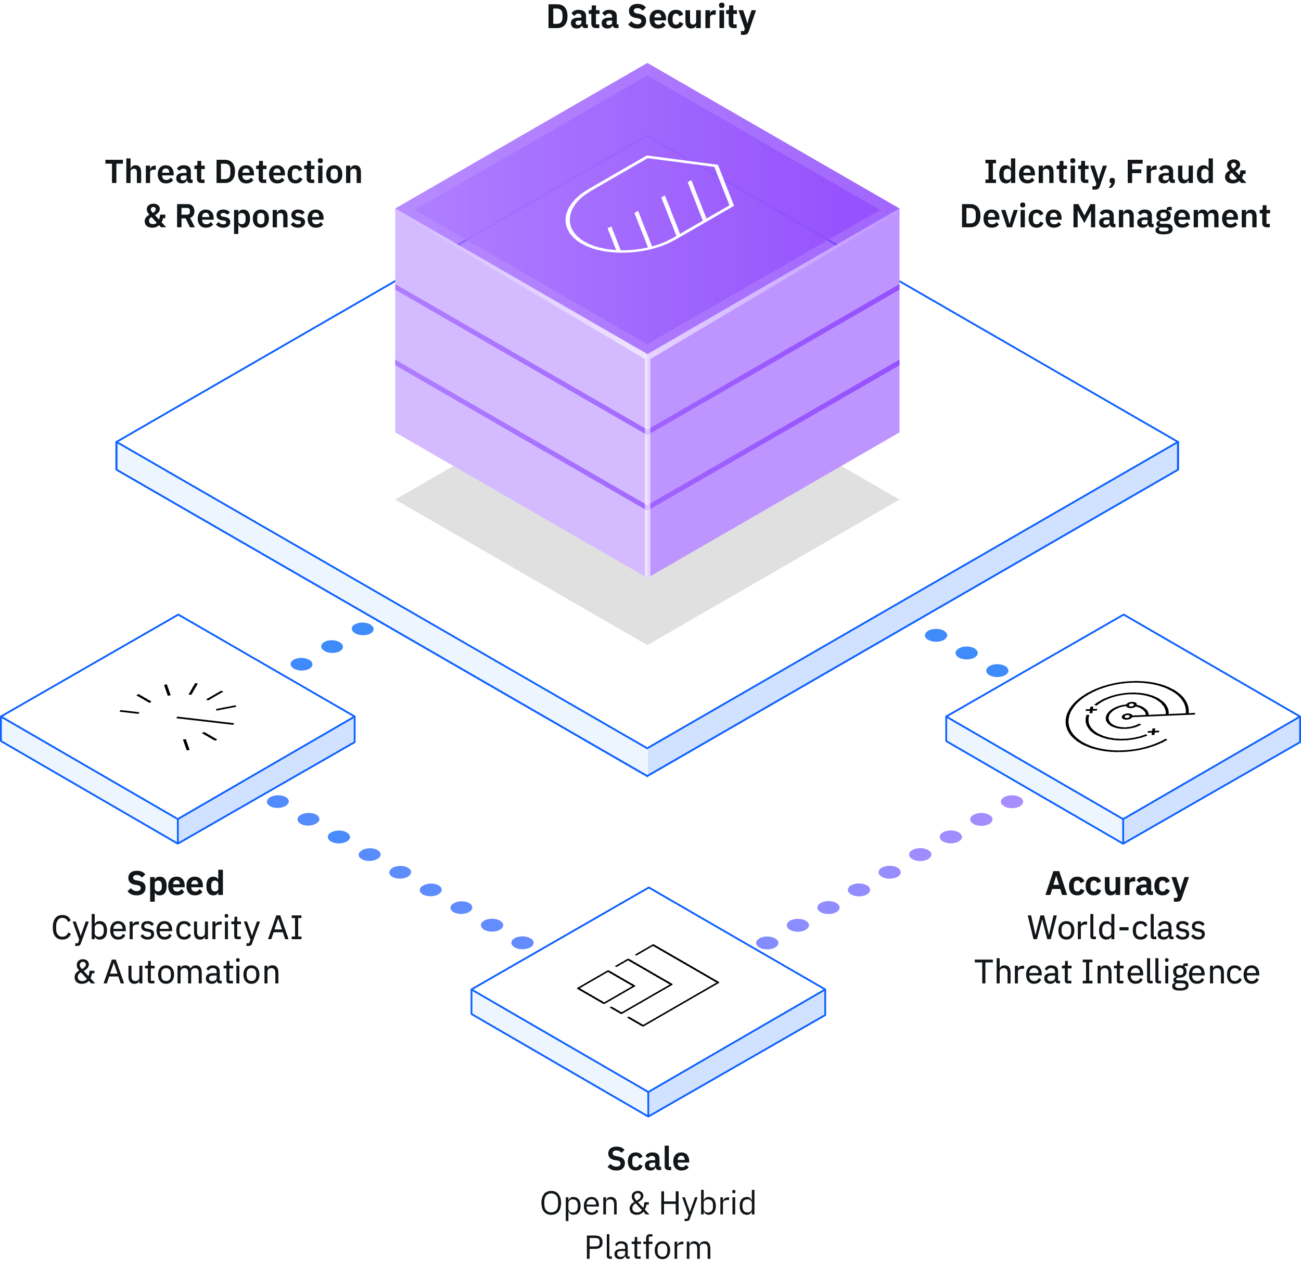
Security that moves with your business
Our differentiation
Greater Scale
1. Open Security Architecture
The world’s largest cybersecurity ecosystem with 900+ out-of-the-box integrations and extensions¹, and a hybrid architecture built on Red Hat OpenShift
Greater Speed
2. Cybersecurity AI & Automation
AI-powered actions, automations, and a common user experience that have been shown to speed investigations and triage by 55% in the first year²
Greater Accuracy
3. World-class Threat Intelligence
Unique insights on emerging threats and business risk using Randori’s attacker’s perspective and X-Force insights from monitoring 150B+ events/day
Notes:
<Presenter: This slide helps describe our differentiation of our open architecture, AI and automation, and world-class threat intelligence.>
Our solutions are differentiated with security that moves with your business to enable:
Greater scale with the world’s largest cybersecurity ecosystem with 900+ out-of-the-box integrations and extensions¹, and a hybrid architecture built on Red Hat OpenShift
Greater speed with it’s Cybersecurity AI-powered actions, automations, and a common user experience that have been shown to speed investigations and triage by 55% in the first year²
Greater accuracy with it’s world-class threat intelligence using unique insights on emerging threats and business risk using Randori’s attacker’s perspective and X-Force insights from monitoring 150B+ events/day
______
Sources:
¹ Number of IBM Security ISV integrations across SIEM, SOAR, and QRadar XDR <supplied by Richard Telljohan>
²Based on IBM's internal analysis of aggregated performance data observed from Managed Security Service engagements with 400+ clients, which showed that average alert triage timeline was reduced by 55% during the first year using AI and automation capabilities that are now part of QRadar. Actual results will vary based on client configurations and conditions and, therefore, generally expected results cannot be provided.

Slide 7
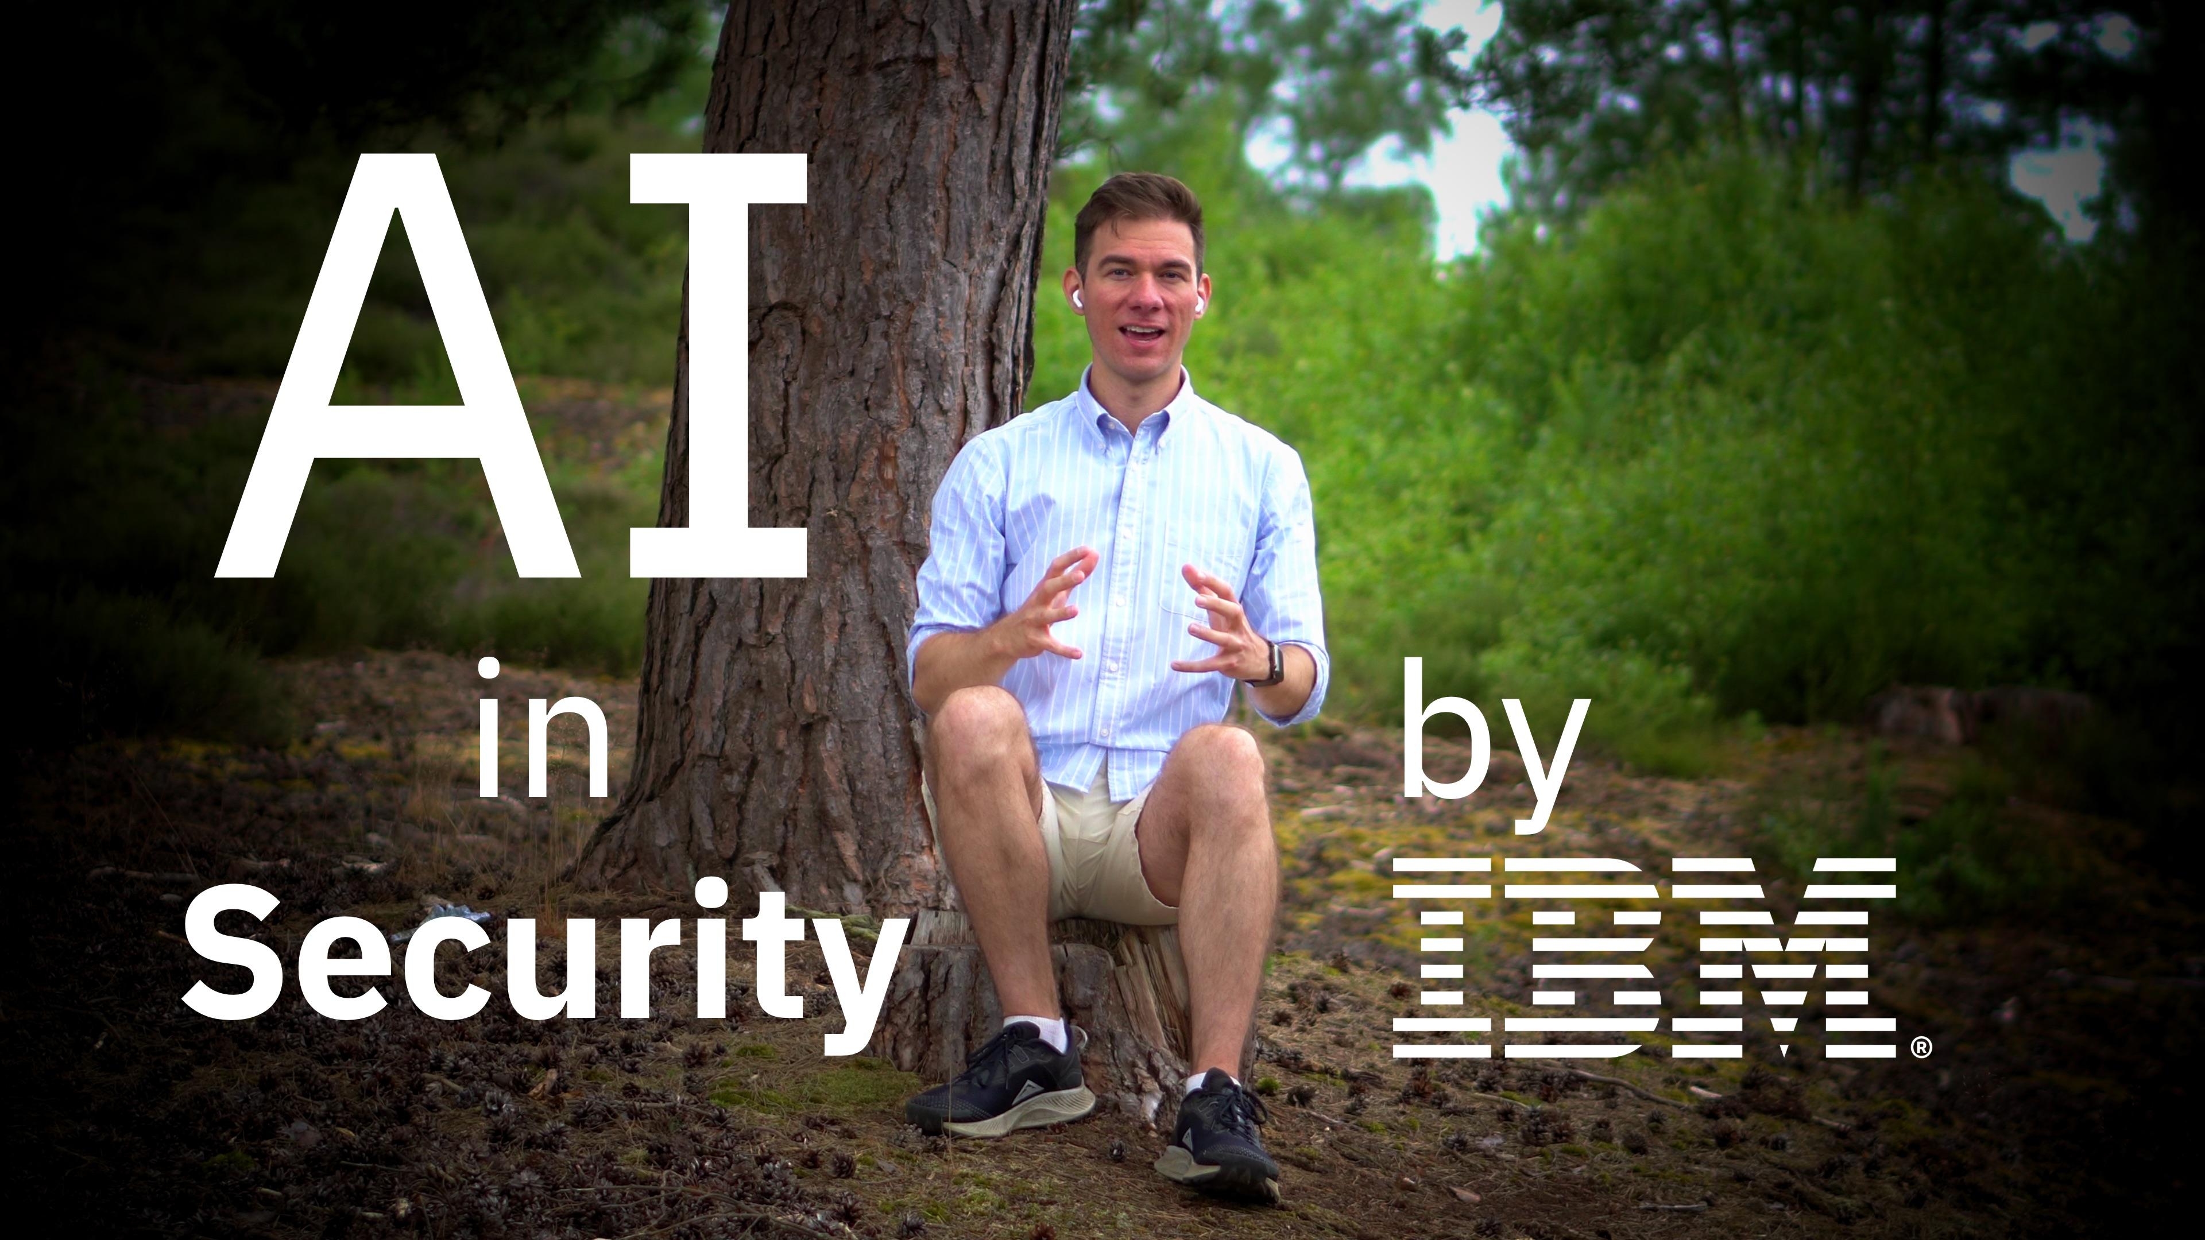
AI-powered security
How we deliver client value
View Sam’s video!
AI-embedded capabilities infused across our portfolio
Threat Detection and Response
Identify threats faster and accelerate response to cyberattacks using automation
Data Security
Automate discovery and classification of mission-critical data and continuously ensure compliance
Identity and Access
Identify unusual user behavior, detect potential insider threats, and quickly mitigate risk
IBM Security QRadar
IBM Security Guardium
IBM Security Verify
Automatically fetches investigation artifacts, generates incident timelines, and orchestrates incident response workflows
Automatically discovers and classifies shadow data, maps data flows, and performs outlier detection for sensitive data stores
Automatically assigns a trust score for risk-based authentication and continuously assesses behavior to detect fraud and malware
AI-enabled outcomes
75%
reduction in security incidents by aggregating and correlating alerts into prioritized threats¹
40% decrease in breaches with centralized visibility and advanced analytics²
15x decrease in user friction associated with multi-factor authentication by incorporating adaptive access³
¹ AI and automation for cybersecurity, IBM Institute for Business Value Report; ² The Total Economic Impact of IBM Security Guardium, Forrester Report; ³ IBM Security Verify customer, leading U.S. insurance company
Notes:
IBM Security is empowering teams with AI today, across: Threat Detection and Response, Data Security, and Identity and Access.
THREAT In Threat Detection, we’re using AI to save Security Analysts time, by automating their typical workflow. As soon as alerts are received from connected Security tools, QRadar Threat Investigator enriches them with further context and threat intelligence. It then uses AI to assess the risk posed to the organisation. This feeds into a cyclical process of data mining for additional context on how the attack has spread, then re-assessing risk given new insights, and repeating this until it can do no more.
It then presents your analyst with a timeline of the incident, how and where it started and developed, and which of your assets were impacted – and even presents them with a MITRE ATT&CK chain graph, with recommended response actions to give a real head-start on remediation.
All of this combined acts as a force multiplier, enabling your analysts to spend more time being proactive.
DATA
In Guardium, we’re utilising AI start to finish in the data security journey. From square one, to help you understand what you need to protect - we’re using machine learning to find shadow data stores you didn’t know existed, then identify and classify sensitive and regulated data. Determining that one store is just post codes, and another is secret Intellectual Property. Then, we help you protect them appropriately, from real-time monitoring, to encryption, redaction, or masking.
Secondly, in the majority of data breaches, attackers steal an admin’s credentials and simply log in. So we use machine learning to perform Outlier Detection - which continually monitors the behaviour of your privileged users , and identifies when potentially malicious activity is happening - this can provide early warning of attacks, even if no existing rule-based detections are triggered.
And finally, we use ML again to help you assess the risk of connections into your data stores in real time, then automate the policy enforcement to keep your business safe, even when your team is offline.
IDENTITY
In Identity, our Adaptive Access technology in Verify is delivering smarter authentication using an AI powered risk engine.
When users attempt to log in, we feed this AI engine as much context as possible, from details on their device and location, to when and how they normally log in. It then calculates a risk score, and automatically adapts the login process accordingly – for highly trusted users, it could offer a totally friction-free login, and for the riskiest, challenge them for passwordless methods, like passkeys.
This allows us to balance having an excellent user experience for as many as possible, while maintaining trust and business resilience. In one organisation, we were able to reduce the MFA challenge rate by 15x by implementing this AI-powered approach.
LINK
While AI in cybersecurity is entering a new era, our clients and partners are already using it to deliver greater speed, scale and accuracy. When IBM announced watsonx, we showed how our Foundation models are being applied to real security use cases, giving a glimpse behind the curtain of how Generative AI will change the threat landscape – let’s take a look.

Slide 8
IBM’s cybersecurity and AI strategy
Envisioning the future with Generative AI
Productivity gains from foundation models and generative AI will reduce human bottlenecks in security
Protecting foundation models, generative AI, and their data sets is essential for enterprise-ready AI
AI will manage repetitive security tasks such as summarizing alerts and log analysis, freeing teams to tackle strategic problems
Secure the underlying AI training data by protecting it from sensitive data theft, manipulation, and compliance violations
AI will generate security content (detections, workflows, policies) faster than humans, expediting implementation and adjusting to changing security threats in real-time
Secure the usage of AI models by detecting data or prompt leakage, and alerting on evasion, poisoning, extraction, or inference attacks (IBM Adversarial Robustness Toolkit)
AI for Security
Security for AI
watsonx
AI will learn and create active responses that optimize over time, with abilities to find all similar incidents, update all affected systems, and patch all vulnerable code
Secure against new AI generated attacks such as personalized phishing, AI-generated malware, and fake identities by using behavioral defenses and multi-factor authentication
Notes:
Recent developments in Generative AI means we have to look at new approaches to help the defenders of the future (on the left), and protecting the foundations of the AI models themselves (on the right).
We have some of our most talented researchers working on use cases for AI and Foundation Models in Security. Broadly speaking this is across three categories:
Managing repetitive Security tasks, like automating the initial triage workflow, and producing human-readable summaries of incidents, to free up analysts to spend more time being productive.
Generating security content, like detection rules, automated remediation workflows, and protection policies. AI will be able to do this faster than humans, and adjust them in real time to optimise your approach in response to the changing threat landscape.
Analysing threats and creating active responses, with the ability to find similar incidents, update affected systems, and patch vulnerable code
On the other side of the coin, IBM are working hard on delivering Trustworthy AI, ready for enterprise use – which means it has to be secure by design and secured from future attacks. Again, this is primarily in three areas:
Securing the training data – by protecting sensitive data from theft, manipulation, and compliance violations.
Securing the usage of AI models themselves, by detecting data leakage, and detecting new attacks like poisoning (where you control a model by changing the training data), extraction (where you steal a model by using queries), or evasion (where you change the model behaviour by changing the input).
Securing against new AI generated attacks, like using AI to rapidly generate new malware, or to mutate existing examples to avoid detection. Plus detecting highly personalised phishing attacks and impersonation.
So that’s a flavour of how watsonx & generative AI will both enrich Security, and necessitate new approaches.

Slide 9
Predict, prevent, and respond to modern threats
Threat Detection and Response
Notes:
First, let’s discuss how we can help you predict, prevent, and respond to modern threats.

Slide 10
Security operations needs major improvement
Predict, prevent, and respond to modern threats
The move to cloud and IT modernization has expanded the attack surface, creating increased security complexity
Poor visibility 2 out of 3 organizations’ external attack surface has expanded in the last year²
Disconnected tools 80% of organizations use at least 10 disparate solutions to manage security hygiene²
Keeping up with attackers
29% of security operations processes are immature and need reengineering before they can be automated¹
Information overload 52% of security environments have become more difficult to manage over the last two years²
51% of organizations struggle to detect and respond to advanced threats¹
¹ ESG: SOC Modernization and the Role of XDR, 2022; ² The State of Attack Surface Management 2022, Randori
Notes:
[Presenter: This slide introduces the key client challenges driving the adoption of a holistic and proactive threat detection and response approach>
Security leaders are overwhelmed by a barrage of cybersecurity technologies, a shortage of skills, and a need to respond more quickly to advanced threats across an ever-expanding attack surface.
As a result, their security teams are struggling to adapt their operations quickly enough to ensure effective detection and response to incidents in their environment.
Some of the key barriers, made even more challenging with limited staff and expertise, include:
Poor visibility across an expanding attack surface leads to blind spots attackers take advantage of. Fact: In the past 12 months, 2 out of 3 organizations’ say their external attack surface has expanded in the past 12 months²
Disconnected tools not routinely maintained and scanned leads to attackers increasingly “living off the land” using legitimate techniques that won’t trigger individual security defenses. Fact: According to Randori, 70% of organizations use at least 10 solutions to manage their security hygiene²
Outdated, noisy, and ineffective manual detection methods that attackers continually bypass. Fact: 32% of organizations lack security automation and orchestration³
Security complexity across many factors such as the expanding threat landscape and growing attack surface, the volume and severity of alerts, and public cloud adoption all contribute to the urgency our clients are facing to modernize. Fact: 52% security environments have become more difficult to manage over the last two years³
Sources:
² The State of Attack Surface Management 2022, Randori: https://www.randori.com/reports/the-state-of-attack-surface-management-2022/
³ ESG: SOC Modernization and the Role of XDR, 2022: https://www.ibm.com/downloads/cas/0Y51VKQB

Slide 11
Current SecOps
Predict, prevent, and respond to modern threats
Modernized SecOps
Technology focused
► Analyst focused
Dependent on experts and heroes
► Scale with expertise and AI
Proprietary ecosystems
► Community collaboration
Notes:
<The intent of this slide is to convey the IBM Point of View of where we need to go to Modernize SecOps>
Technology focused -> Analyst focused
Analysts today experience information overload due to multiple tools across various interfaces. These analyst end up having to spend too much time synthesizing data in order to glean meaningful insights across tools. By focusing on the analyst, and delivering a unified analyst experience, organizations can act faster to address threats using higher fidelity alerts and insights with less screen switching.
Dependent on experts and heroes -> Scale with expertise and AI
Current Security Operations often struggle to keep up with attackers given competing SOC priorities, skills gaps, and not enough people to get everything done. Most teams are dependent on experts and heroes that don’t scale. In order to combat this dependency, we need to modernize the SOC for efficiency and let AI enabled technology do the heavy lifting.
Proprietary ecosystems -> Community collaboration
Too much time is spent on deploying and onboarding disparate technology, it’s often difficult to implement and integrate and can often lead to underutilization of critical features. With bi-directional integrations that are easy to connect, organizations can streamline data onboarding and consumption, freeing up time and resources for more high-value projects.

Slide 12
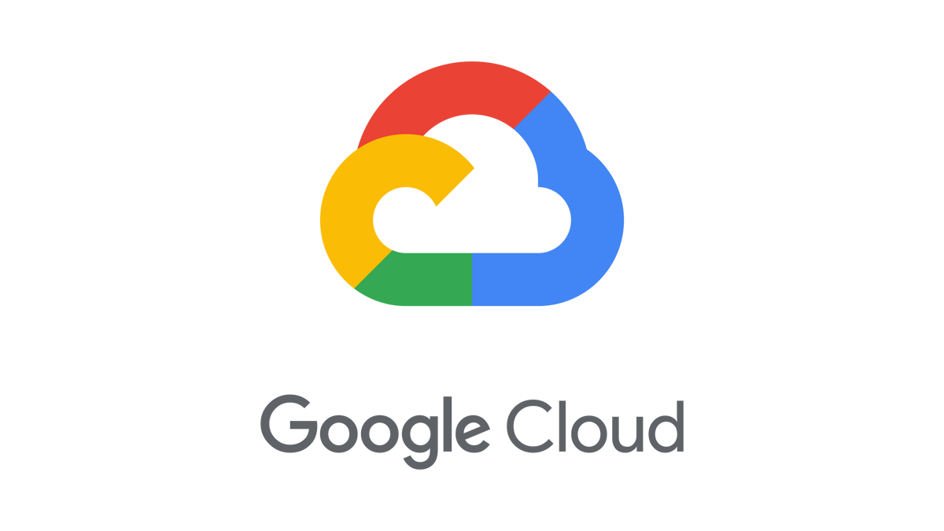
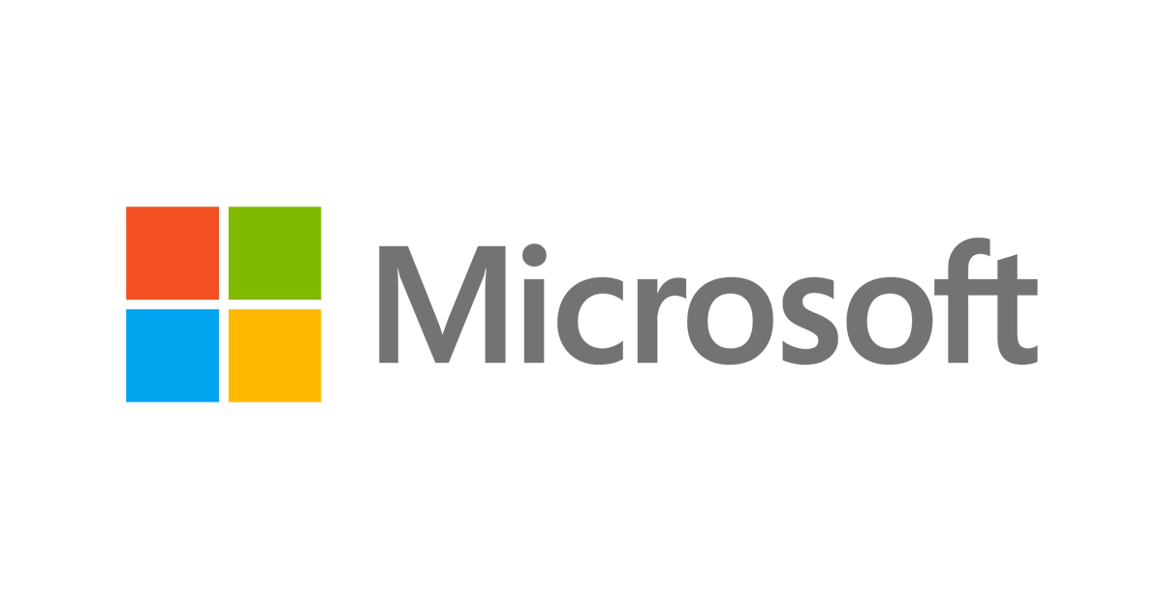







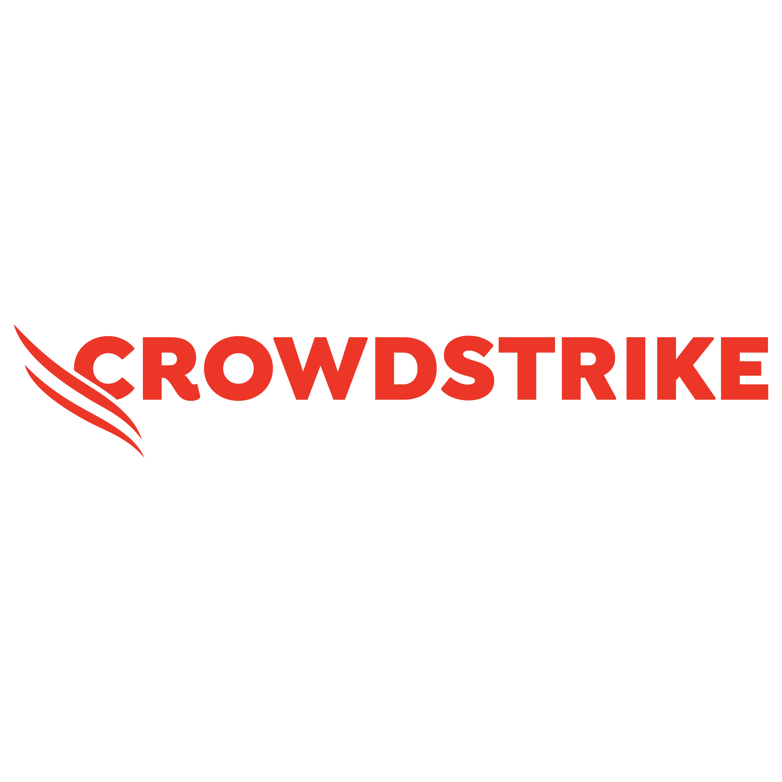

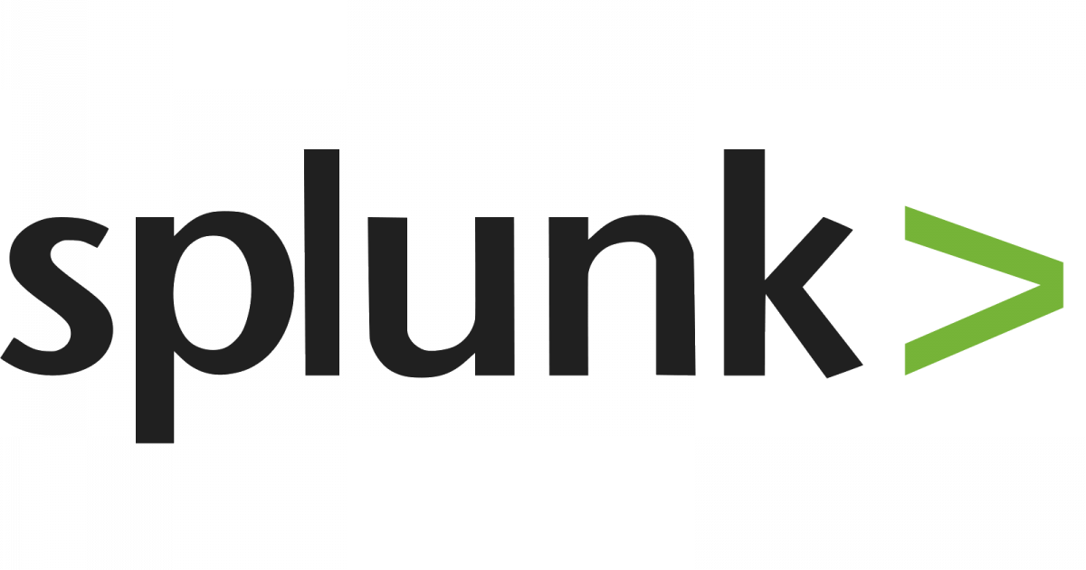


Modernize security operations with greater speed and visibility
Predict, prevent, and respond to modern threats
The evolution of the IBM Security QRadar Suite
Designed around the analyst experience Enable better decisions quickly using a common, streamlined, Unified Analyst Experience (UAX)
Gain accurate insights quickly Streamline workflow with automation and AI designed for analysts, continuously updated threat X-Force threat detection and response expertise
Work with what you already have and expand to where you want to go Built to meet you where you are using an open modular platform, standards, and ecosystem, with bi-directional integrations including federated search
Know your attack surface
Accelerate your threat detection and response capabilities
ASM
EDR
Log Insights
SIEM
SOAR
Federated Access
and XDR
Unified Analyst Experience
Risk-driven prioritization | Built-in expertise | AI-driven outcomes
X-Force Threat Intelligence and Expertise
Open Platform. Open Integration. Open Threat Intelligence.
Notes:
<Intent: This slide is introducing the new QRadar Suite for the first time, articulating what’s new and the unique differentiated value. Note: If product drill-down is needed, each pillar is clickable in slide show mode and links to their respective product slides in optional section of this deck. >
Intro
The new QRadar Suite is the next evolution of our threat detection and response suite, designed around the modern security analyst experience.
Highlights
Designed around the analyst experience: Refined in collaboration with hundreds of real-world users, the suite features a common user interface that assists security analysts throughout their investigation and response workflow.
Gain accurate insights quickly: It features AI and automation innovations that have been shown to speed alert investigation and triage by 55%. (Based on IBM Managed Security Services results with 400+ customers, based on aggregated annual performance data. Using advanced threat disposition system, response time improved by 55% during the first year of use)
Work with what you already have and expand to where you want to go: The suite brings together the core technologies needed across threat detection, investigation and response - built around an open source foundation designed for open integrations and a wide partner ecosystem for flexibility across IBM and third-party toolsets. It includes native, pre-integrated capabilities for Threat Intelligence, Log Management, EDR, SIEM, NDR and SOAR.
Transition
Stop for questions and feedback here then can follow up with “Now let’s dive into the Unified Analyst Experience”

Slide 13
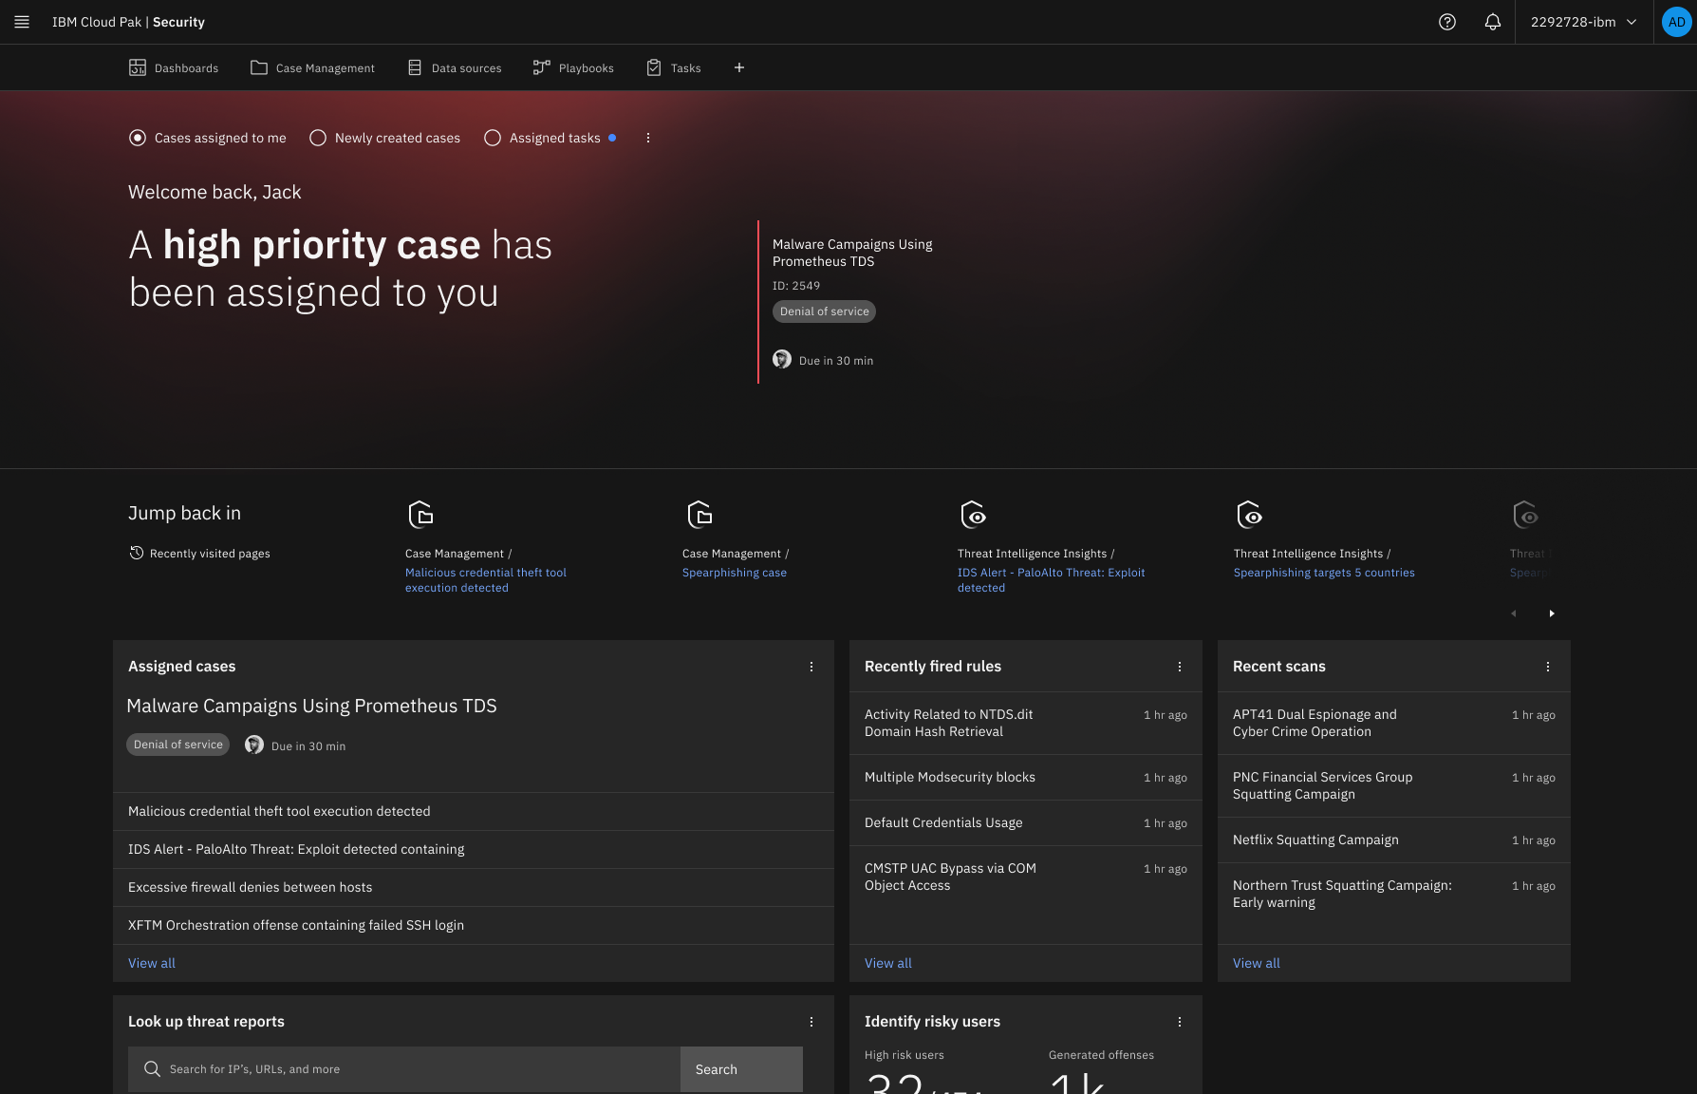
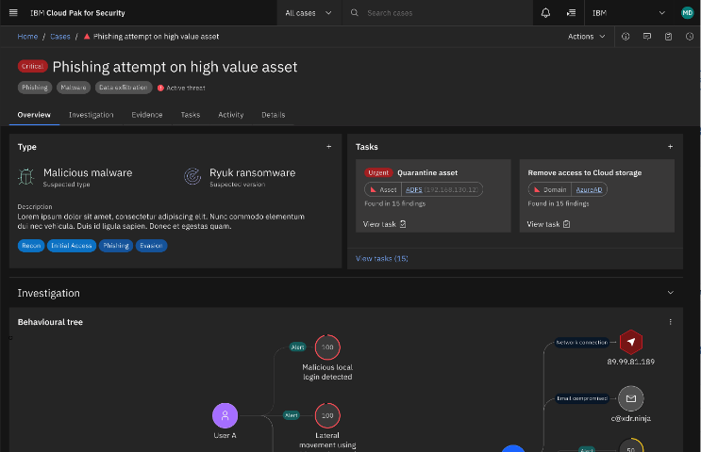
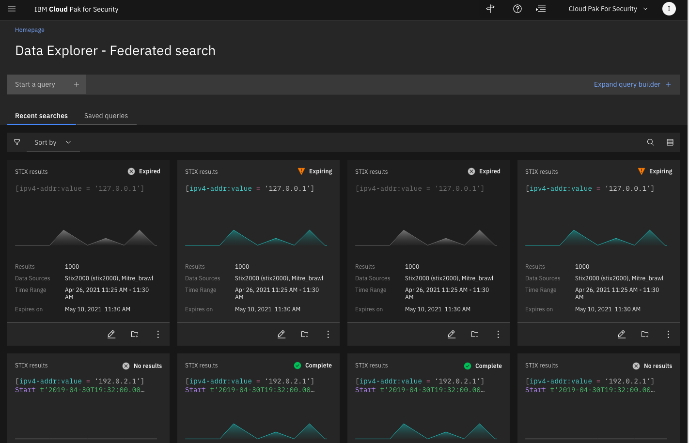
Enable better decisions quickly using a common set of UAX capabilities
Predict, prevent, and respond to modern threats
Traditional Experience
Unified Analyst Experience
What?
When?
Where?
Who?
How?
90%+ analyst time saved on investigating an incident²
8+ security UI’s
30+ hours of tool training
2+ days of response time
Manual investigation
1 common UX
Continuous learning
< 30-minute response time¹
Automated investigation
Take action
“ I equate the UAX to five additional FTEs, it was easier to get better data out of my tools with AI, then investing in more people. It made my people faster and better at their job.” ¹
Enrich, correlate, and prioritize
Automated investigation and response recommendations
Federated search and threat hunting
¹ North American State Government Agency
² Forrester’s TEI Study of QRadar SIEM, April 2023
Notes:
<Presenter: Introduce the new Unified Analyst Experience capabilities.>
Intro
The new QRadar Suite has been architected around a single, unified analyst experience that has been built in unison with early adopters to assist the security analyst throughout their alert investigation and response workflow, taking the typical investigations and response times from hours and days, to seconds and minutes.
Highlights
A reinvented Analyst experience that unifies capabilities across Security solutions including SIEM, SOAR, and log management, as well as context and workflows across IBM QRadar and 3rd party solutions.
Automated investigation, root cause analytics, and mitigation recommendations.
AI driven alert disposition analysis that intelligently prioritizes alerts and learns from analyst feedback.
Federated search and investigation, enabling analysts to leverage data and insights from all their security tools.
Transition
UAX is a common set of capabilities for our IBM Security QRadar Suite solutions. Now let’s dive into how we gain accurate insights quickly.

Slide 14
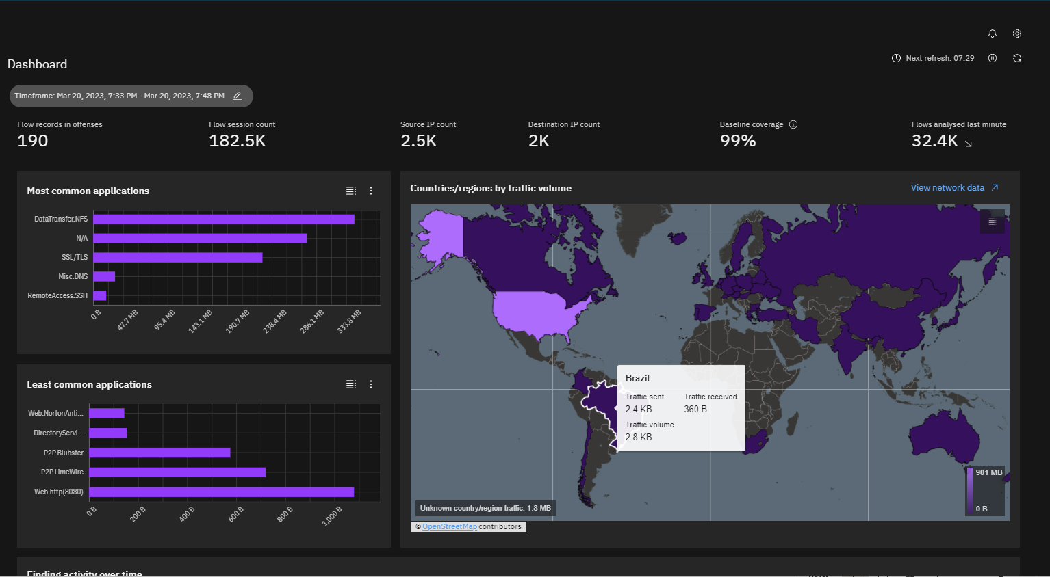
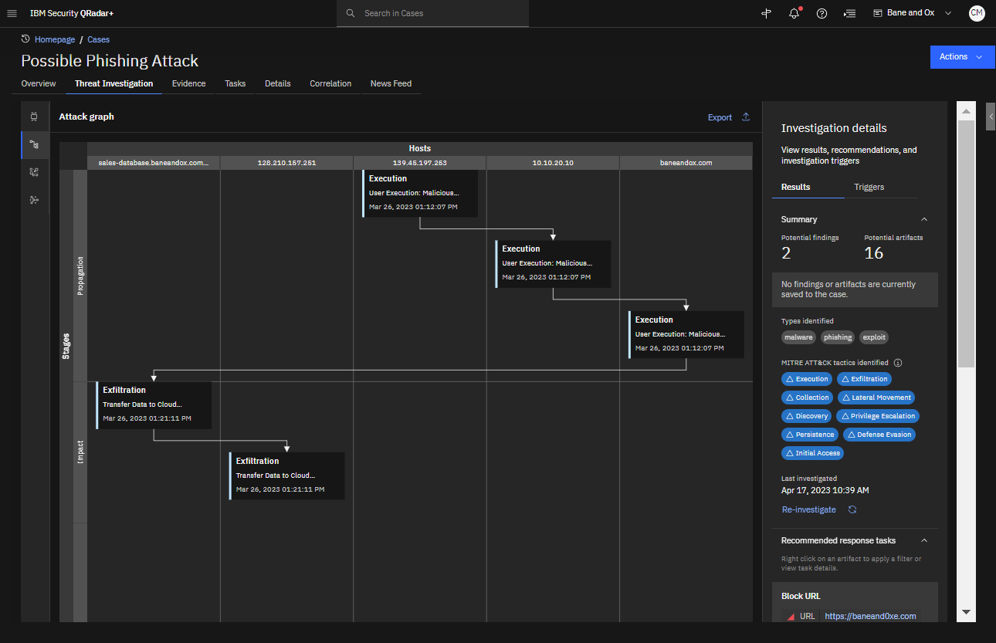
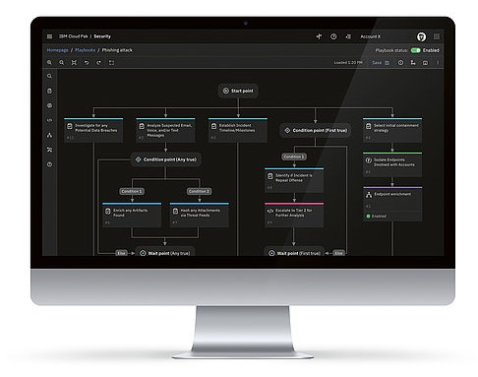
Gain accurate insights quickly powered by X-Force expertise and AI
Predict, prevent, and respond to modern threats
Streamline your SOC with automated and intelligent detection and response
85%
reduction in incident response time¹
75%
reduction in risk of a security incident²
Keep up with the threats
Continuously updated X-Force and community threat prevention and detection intelligence and AI that detects and responds autonomously in near real-time to previously unseen threats
Accelerate triage and action with Threat Investigator
Leverage AI to rapidly investigate and prioritize high fidelity alerts based on credibility, relevance, and severity of risk
Respond faster with automation and orchestration
Respond x7 faster with dynamic playbooks that combine people, process and technology
¹ ibm.com/case-studies/doosan-digital-innovation
² Forrester’s TEI Study of QRadar SIEM, April 2023
Notes:
<Presenter: Introduce how they can gain accurate insights quickly with QRadar Suite capabilities.>
Intro
The new QRadar Suite streamlines your SOC with automated and intelligent detection and response.
Highlights
Keep up with the threats and accelerate triage and action: The QRadar Suite gives you complete visibility into your entire environment. It collects data from endpoints, network devices, cloud environments and even other data lakes. Then it applies advanced analytics with alert consolidation and risk prioritization to highlight your most critical threats. You can make quick and informed decisions with attack visualization storyboards and leverage automated alert management and advanced continuous learning AI capabilities. In addition, QRadar Suite capabilities can automatically investigate threats, with multi-stage analysis to accurately triage incidents faster. IBM's global threat intelligence, with automated threat hunting provides deep search capabilities so you can proactively hunt threats.
Respond faster with automation and orchestration: Use AI and automation to bridge the skills gap - artifact correlation, investigation, and case prioritization is automated, even before someone touches the case. The playbook evolves as the investigation proceeds, with threat enrichment happening at each stage of the process.

Slide 15


Accelerate your security, starting where you need to
Predict, prevent, and respond to modern threats
Wide set of integrations that work with existing solutions to allow stepwise adoption
3,000+ Open Sigma SIEM rules
550+ Log adapters and apps for QRadar SIEM
300+ QRadar SOAR integrations
40+ Federated search sources
10+ Threat intelligence sources
150+ Open ecosystem vendors
Broader adoption of IBM solutions adds capabilities, context, insights and automation to the analyst experience with little incremental training or integrations
Available as licensed software or SaaS
Examples
Start where you need, and easily expand for additional capabilities
ASM
SOAR
SIEM
EDR/XDR
EDR/XDR
EDR/XDR
Log Insights
Log Insights
Start with what you have, and add what you need
QRadar SOAR
QRadar SOAR
QRadar SOAR
QRadar SIEM
QRadar SIEM
ASM
Log Insights
QRadar SIEM
Log Insights
SOAR
SOAR
SOAR
SIEM
SIEM
SIEM
EDR
EDR
EDR
Notes:
<Presenter: The intent of this slide is to explain why it’s better together when you use multiple QRadar products but customers can also start with third party solutions and add IBM solutions for added value>
Intro: Proactive threat detection and response through purpose-built, bi-directional integrations. Wherever you’re starting from, we can extend your SOC maturity/capabilities with the QRadar suite of products.
Highlights
Our clients who use multiple products get the most out of IBM Security’s innovations.
Not only is there a consistent unified experience but you gain contextual analysis through the same schema and data ingestion processes
Eliminate operational and visibility gaps between siloed tools
Save time using AI-driven models, prebuilt content, and joint out-of-the-box use cases
Leverage 24/7 global support and technical expertise through an end-to-end use case --all in one place without having to chase down multiple vendors
Cost effective volume discount – the more you buy, the more you save
SIEM + SOAR: Respond to high priority incidents faster with automated incident escalation from SIEM. Gather additional threat context to drive more thorough investigations and keep a continuous analytics feedback loop to improve security process and detection between SIEM and SOAR. Use SOAR as a single dashboard with auto-generated QRadar Offense Details displaying critical associated events, triggered rules, and more.
EDR + SIEM + SOAR: EDR’s AI engines automatically collect and group events from across the endpoint ecosystem and consolidates them into few high-fidelity alerts within SIEM. Leverage SOAR to auto-create a case, visualize threat activity and search directly from one dashboard to take quick corrective actions such as ending processes, isolating endpoints, and enforcing compliance policies.
Randori Recon (ASM) + SIEM + SOAR: Uncover blind spots, misconfigurations, and potential shadow IT with Randori and automatically trigger alerts in SIEM if new assets are associated with the organization or if assets suddenly become riskier for analysts to investigate. Prioritize and automatically create a case within SOAR to action. Remediate using SOAR playbooks and continuously provide information across tools on any changes to exposed assets to learn and trigger new mitigation strategies.
Transition: The QRadar product suite truly brings a seamless set of capabilities designed to give full-stack visibility, intelligent insights, and faster response.
_____ 1. Integration Scenario 1
Respond to high priority incidents 85% faster with automated escalation; Source: ibm.com/case-studies/doosan-digital-innovation
Drive more comprehensive investigations with X-Force Threat Intelligence enrichment
Improve security analytics through a continuous feedback loop
2. Integration Scenario 2
Automatically collect and consolidate high-fidelity alerts across the endpoint ecosystem
Take quick corrective actions through automated case creation, threat activity visualizations and searches– all from one dashboard
3. Integration Scenario 3
Prioritize risks, using an attacker’s perspective
Quickly remediate using playbooks that action across endpoints, networks, cloud servers
Learn and trigger new mitigation strategies through continuous exposed asset updates

Slide 16
Centralize data security and compliance
Data Security
Notes:
Next, let’s discuss how we can help to protect data across the hybrid cloud.

Slide 17
Top three data security challenges
Centralize data security and compliance
Data Explosion in the Cloud
Costly Breaches
Compliance Complexity
63%
Companies that have exposed sensitive data in the cloud¹
Enterprises are struggling to protect structured and unstructured data that’s multiplying across public clouds, data warehouses, and popular SaaS apps
$9.44M
Average cost of a data breach in the United States¹
Attackers continue to steal data via stolen credentials, phishing and exploitable vulnerabilities – but have also shifted focus to public clouds and their misconfigurations
1000s Of hours spent a year by organizations to help facilitate audits²
A complex web of regulations – DORA, GDPR, CCPA, SOX, PCI, HIPAA, etc. – means more than ticking boxes, it means diving deep into unauthorized access, data lineage, and movement
1. “IBM Cost of Data Breach(IBM, 2022) 2. The Total Economic Impact™ Of IBM Security Guardium, Forrester
Notes:
[Presenter: The notes below set the context for how critical data is to the business and the challenges associated with protecting it across a complex data security landscape.]
The value of data has never been greater than it is today, yet enterprises are struggling to protect it as structured and unstructured data is exploding across public clouds, data warehouses, and popular SaaS apps.
It’s constantly at risk from attackers continuing to steal data via stolen credentials, phishing and exploitable vulnerabilities – but have also shifted focus to public clouds and their misconfigurations.
Enterprises spend thousands of hours a year helping to facilitate audits due to complex web regulations – DORA, GDPR, CCPA, SOX, PCI, HIPAA, etc. – compliance means more than ticking boxes, it means diving deep into unauthorized access, data lineage, and movement.
Companies need help to:
First, identify where critical data is stored, how it’s being accessed and used – and of course, how to best protect it regardless of where it’s stored
Uncover risks early, create and enforce policies, and protect data in motion and at rest
Simplify the process of meeting compliance and privacy mandates (e.g., GDPR, CCPA, SOX, HIPAA, and others) to easily verify regulated data is protected and mitigate costly audit failures and breach costs
The needs just seem to keep growing, while the data security fundamentals remain the same. An end-to-end continuous approach is needed, and we can help…
_______ Sources: ¹ “IBM Cost of Data Breach(IBM, 2022) ² The Total Economic Impact™ Of IBM Security Guardium, Forrester

Slide 18
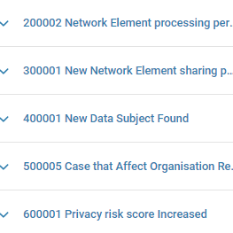
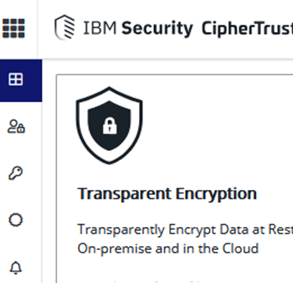
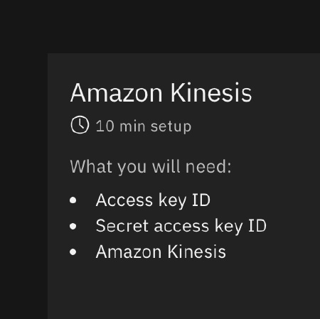
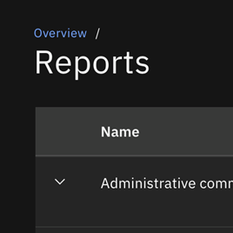
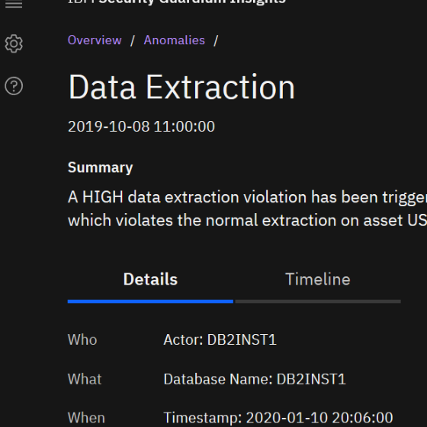
IBM Security Guardium Portfolio
Centralize data security and compliance
Discover
Automate discovery and classification of on premises and cloud data and uncover critical vulnerabilities
Encrypt
Safeguard privacy and confidentiality of data at rest, in motion, and in use with encryption and key management
Monitor
Protect and harden on-prem and cloud data sources, including Azure Event Hubs, AWS Kinesis, Snowflake, SAP, etc.
Analyze
Generate reports and automate notification on long-term data activity within seconds, across the audit lifecycle
Respond
Identify and respond to compliance and data security risks, across environments and teams, from one place
IBM Security Discover and Classify
Guardium Data Encryption and Key Lifecycle Manager
Guardium Data Protection and Insights and Vulnerability Assessment
Notes:
[Presenter: This is the transition from the previous slide discussing the challenges many organizations face with their data security. Traditionally, data security has been delivered by disparate products, which has resulted in operational inefficiencies and an incomplete view of the data security and compliance landscape. Guardium, as a mature and market leading Data Security Platform, solves these challenges by aggregating data protection requirements across data types, storage silos and ecosystems, significantly increasing the visibility of, and control over, data - and therefore, helps put organizations in a position to truly secure their data.]
IBM Security Guardium is a market-leading data security platform to protect what matters most – your enterprise data – whether in the cloud or on premise. IBM Security Guardium delivers value by providing an end-to-end data security framework that discovers, encrypts, monitors, analyzes, and responds to compliance and data risks across environments and teams, all from one place. Key capabilities of the Guardium portfolio include:
Automatically discover and classify sensitive data across on premises and cloud. IBM Security Discover and Classify, in partnership with 1touch.io, provides visibility, context and insight into data. It uses network analytics, AI and machine learning to continuously find and catalog sensitive and protected data of any type, anywhere. IBM Security Discover and Classify is a powerful complement to Guardium products and the IBM Security portfolio.
Encrypt and protect data at rest, in motion, and in use with encryption, tokenization, data masking and key management capabilities. IBM Security Guardium Data Encryption(GDE) helps protect and control access to data across the hybrid multicloud environment.
Monitor activity across clouds from a centralized hub using IBM Security Guardium Insights for IBM CloudPak for Security. Guardium Insights for IBM Cloud Pak for Security can either work together with Guardium Data Protection or on its own through agentless streaming directly from DBaaS sources such as AWS Kinesis and Azure Event Hubs to help organizations streamline data security and compliance infrastructure and processes.
Help automate compliance using Guardium Data Protection to uncover regulated data in your data stores and generate reports using pre-built templates for regulations such as PCI DSS, SOX, HIPAA, GDPR, CCPA and many more.
Detect malicious behaviors and threats and respond by scanning for known weaknesses related to configuration, user privileges, authentication, authorization, patches and more using Guardium Vulnerability Assessment. Guardium Vulnerability Assessment scans data environments to detect vulnerabilities, security gaps, and threats that could be exploited by hackers and suggests remedial actions.
Through customer interviews and data aggregation, Forrester concludes that: IBM Security Guardium has the following three-year financial impact:
Reduced probability of a breach by 40%
Increased automation saves 79 hours during database analysis
Effort required to complete an audit decreased by 75%
Client Reference: Nationwide Mutual Insurance Company / United States - https://rv.roinnovation.com/ibm/UnifiedSearch.aspx?Imp=b8175596598342958d12b45daf70b598
Client Case Study: Commercial International Bank S.A.E. (CIB) - www.ibm.com/case-studies/commercial-international-bank/
_____ Sources:
Forrester’s Total Economic Impact of IBM Security Guardium Study
https://www.ibm.com/products/ibm-security-discover-and-classify
https://www.ibm.com/products/guardium-data-encryption
https://www.ibm.com/products/guardium-insights
https://www.ibm.com/products/ibm-guardium-data-protection
https://www.ibm.com/products/ibm-guardium-vulnerability-assessment

Slide 19
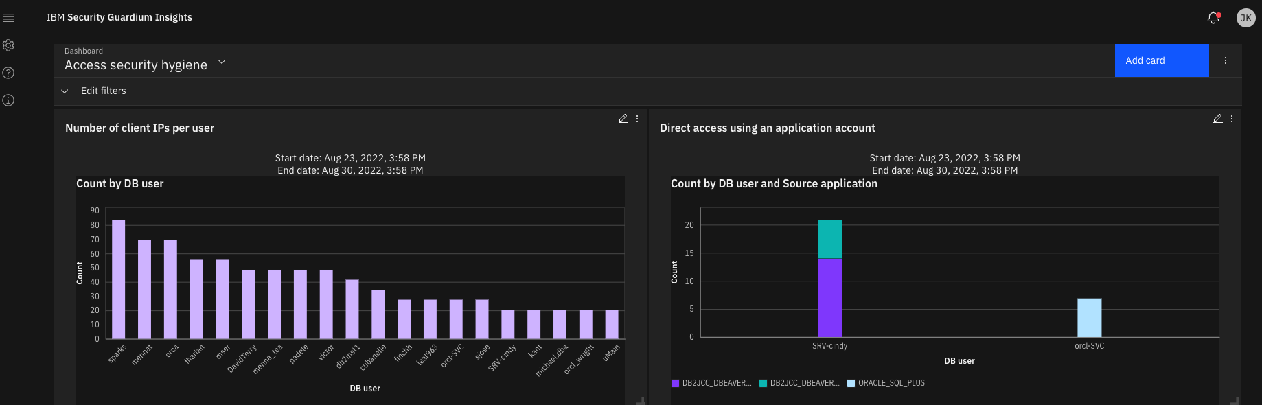
IBM Security Guardium Insights
Centralize data security and compliance
A data security platform to help clients protect data wherever it resides
Decrease breaches
40%
with centralized visibility and advanced analytics
Smarter data threat response Proactive data threat hunting and scoring using AI-based analytics, and share contextual insights across teams for an orchestrated response
Faster compliance
Custom compliance policy, audit workflows, and reporting—as well as long-term data storage—help meet compliance goals faster
Reduce cost of ownership
Easy to use, deploy, and adapt to the hybrid cloud—and connect to an open ecosystem of 3rd party security tools, data, and clouds
Reduce audit prep time
75%
with automated compliance audit and reporting
Save up to
1000
hours of DBA time with automated processes
Source: “The Total Economic Impact of IBM Security Guardium”, Forrester
Notes:
[Presenter: This slide serves as “just don’t take our word for it”, see what a leading independent and objective research firm was able to validate in terms of business benefits of using Guardium gathered from interviews with security leaders using the product.]
IBM Security™ Guardium Insights simplifies your organization’s Data Security architecture and enables access to long-term data security and compliance data. It provides security teams with risk-based views and alerts, as well as advanced analytics based on proprietary ML technology to uncover hidden threats. Guardium Insights gives security professionals the ability to quickly create data security and audit reports, monitor activity in on-premise and DBaaS sources, and take action from a central location.
IBM commissioned Forrester Consulting, an independent and objective research-based consulting firm, to conduct a Total Economic Impact (TEI) study and examine the potential return on investment (ROI) enterprises may realize by deploying IBM Security Guardium. Some of the key business benefits customers highlighted were:
Reduce audit prep time by 75% with automated compliance audit and reporting. Guardium eliminated the need to collect data from disparate sources and provides one central location with all the required information readily available. The efficiencies created from this workflow saved $2.1M.
Decrease breaches by 40% with centralized visibility and analytics. The vulnerability management, threat monitoring and detection, and asset prioritization capabilities provided by Guardian have enabled the customer to avoid the potentially significant costs of a data breach. Over three years, these costs amount to a total of $990K.
Saving up to 1,000 hours of DBA time annually with automated processes. Guardium allowed this customer to automate previously manual processes, saving DBAs significant time. These efficiencies saved the organization $822K over three years.
Source: The Total Economic Impact™ Of IBM Security Guardium, Forrester Consulting, October 2020

Slide 20






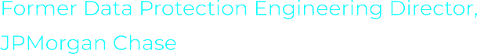

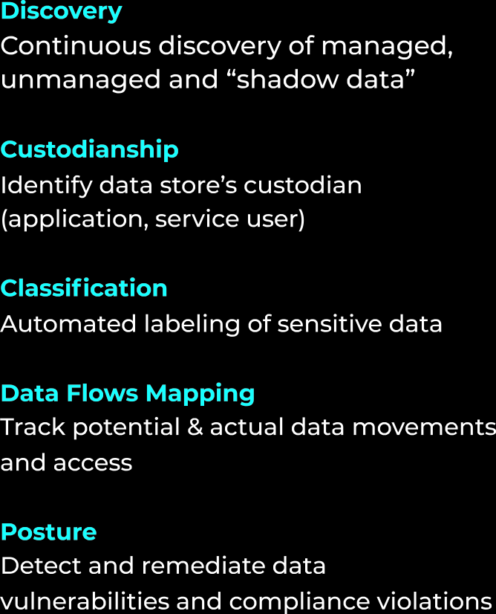
Strategic vision for the future
Centralize data security and compliance
IBM is on a path to secure data across hybrid cloud, Polar Security accelerates this strategy
PHASE 1
Protect Data On-Premises
PHASE 2
Protect Data Shifting to Cloud
PHASE 3
Protect Data Born on Multiple Clouds
Guardium Data Protection
Guardium Insights SaaS
NextGen Data Security Platform
Polar Security extends visibility into cloud service providers, critical SaaS applications, and unstructured data sources in the cloud
Agentless, SaaS-based deployments
Automated discovery of shadow data
Alerts on data misconfigurations
Monitoring of data flows across clouds
Support for IaaS & SaaS apps
Notes:
https://newsroom.ibm.com/IBM-to-Help-Automate-Cloud-Data-Protection-with-Acquisition-of-Polar-Security
IBM to Help Automate Cloud Data Protection with Acquisition of Polar Security
IBM has acquired Polar Security, an innovator in technology that helps companies discover, continuously monitor and secure cloud and software-as-a-service (SaaS) application data – and addresses the growing shadow data problem.
The pandemic drove a sharp increase in cloud adoption, leaving organizations to grapple with a deluge of cloud data that led to more silos and “shadow data”– sensitive data not being tracked or managed.
Founded in January 2021, Polar Security is a pioneer of data security posture management (DSPM) – an emerging cybersecurity segment that reveals where sensitive data is stored, who has access to it, how it’s used, and identifies vulnerabilities with the underlying security posture, including with policies, configurations, or data usage.
An agentless platform that connects within minutes, Polar Security can automatically find unknown and sensitive data across the cloud, including structured and unstructured assets within cloud service providers, SaaS properties, and data lakes. Once discovered, Polar Security classifies the data, maps the potential and actual flow of that data, and identifies vulnerabilities, such as misconfigurations, over-entitlements, and behavior that violates policy or regulations.
Based on a risk-based prioritization methodology, Polar Security provides remediation reports that pinpoint the most pressing security risks and compliance violations and provides an analysis of the underlying causes and practical recommendations to address them. Financial terms were not disclosed.
IBM plans to integrate Polar Security’s DSPM technology within its Guardium family of leading data security products. With the integration of Polar Security’s DSPM technology, IBM Security® Guardium will provide security teams with a data security platform that spans all data types across all storage locations – SaaS, on premise and in public cloud infrastructure.
Clients can learn more about Polar Security by visiting: https://www.polar.security/

Slide 21
Authenticate users and manage employee devices
Identity, Fraud & Device Management
Notes:
Next, lets discuss how we can help you to authenticate users and manage employee devices

Slide 22
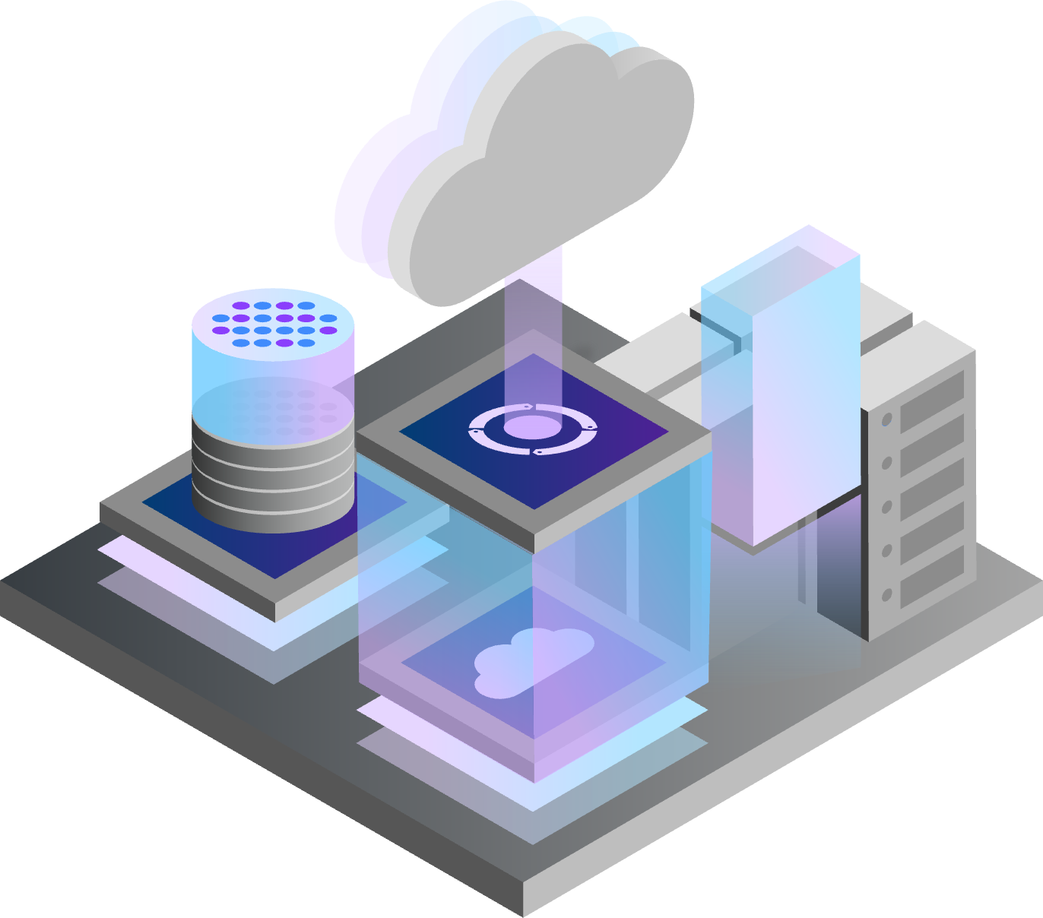






Identity is the fabric that underpins business transformation
Authenticate users and manage employee devices
Accelerate the journey to cloud
Increase technical agility and operational efficiency by modernizing IAM infrastructures to cloud-based or hybrid
Deliver risk-based access
Based on Zero Trust principles, minimize friction for users by delivering challenges commensurate to their risk
Simplify deployment
One-platform consolidation of workforce and consumer access, identity governance, directory, and even privacy and consent management
Hybrid cloud adoption
Identity
Digital transformation
Zero Trust security
Notes:
<Presenter: This slide sets the stage for identity being the “fabric” that underpins the modern enterprise, meaning it's the connection of individuals and devices to the hybrid cloud resources they need to deliver business transformation.>
We know forward-leaning companies, the ones that will lead in the next era, are embracing change at an accelerated pace.
They’re embracing hybrid cloud, to match the right workload to the right cloud environment for their business, in new and open ways.
Their experiencing rapid digital transformation where resources are being accessed by a growing number of siloed constituents (including employees, suppliers, partners, and customers) all using multiple devices from distributed and remote locations.
And because they’re faced with evolving business disruptions like costly ransomware attacks targeting their most critical assets, They’re looking to build enduring security programs using a Zero Trust strategy in order to:
Establish a state of least privilege -- so no user or app has any more access than what’s needed.
Verify continuously, as apps and users access data and tools.
And finally, to always assume a breach.
Adapting to this change is dependent on one universal non-negotiable requirement...
Identity. It’s the fabric that underpins the modern enterprise because it facilitates communication and collaboration to connect hybrid cloud resources with the individuals that need to access them.

Slide 23



IBM Security Verify for frictionless identity protection
Authenticate users and manage employee devices
Safely connect any identity to any resource with deep context and intelligence
Continuous Access Control
Single Sign-On and MFA
Adaptive access
Passwordless authentication
Lifecycle management
Privileged access
Privacy and consent management
Workforce Identity
Drive cloud modernization, technical agility and user productivity
Consumer Identity
Deliver on-demand, personalized, and trusted experiences
Uniquely broad
Uniquely flexible
On-Premise for full customization
SaaS for rapid deployment and integration
Hybrid for diverse risk groups
Access Management
Identity Governance
Identity Directory
Privileged Access Management
Notes:
[Presenter: We advise clients who are starting on their Zero Trust journey to start with identity, as it’s foundational for identity-based access and one of the top vectors for external attacks. With incremental investments in process, it also can demonstrate quick wins. Although the implementation of MFA and the application of least privilege can improve the security of critical apps and data assets, it’s not Zero Trust without controls protecting those apps and assets, and visibility into where they reside. This is where other areas of the IBM Security portfolio – i.e. Guardium, MaaS360, Qradar XDR, SASE (with Zscaler, and Zero Trust Acceleration Services– help our clients complete their Zero Trust architecture.]
Identity and Access Management is a foundational element of a Zero Trust strategy as identity-based access is one of the top vectors for external attacks, as highlighted earlier. Let’s take a deeper look at IBM Security Verify and how it provides deep, AI-powered context for both consumer and workforce identity and access management. Protect your users and apps, inside and outside the enterprise, with a low-friction, cloud-native, software-as-a-service (SaaS) approach that leverages the cloud.
Core Verify features include:
Single Sign On (SSO) for centralized access control and reduced password fatigue for cloud and on-prem applications.
Adaptive Access utilizing continuous risk-based authentication and adaptive access control.
Advanced Passwordless Authentication with QR code and FIDO2 authentication.
Lifecyle Management to provision, audit and report on user access and activity through lifecycle, compliance and analytics capabilities.
Privileged Access to discover, control and audit privileged access and centrally manage passwords in hybrid multicloud or on-prem environments.
Privacy and Consent Management for addressing privacy laws utilizing easy templates to capture granular requirements and support self-service.

Slide 24


IBM adopts next-gen digital authentication across its workforce and customers
Authenticate users and manage employee devices
Simplifying secure identity and access for over
27 million
internal and external identities using advanced authentication like passwordless QR and FIDO2
ibm.com/case-studies/ibm-on-ibm-security-verify
“ With IBM Security Verify, to anyone who interacts with IBM, we can now provide frictionless, secure, state of the art access to information resources.”
Gary Schmader, Sr. Manager, Assured Identity and Security Operations, IBM
Notes:
And just as IBM recommends to its own clients before purchasing a new solution, the Identity and Cybersecurity Operations team captured their own requirements and compared several solutions across the market.
After careful consideration, they chose Verify (SaaS) to secure the identity and access for more than 27 million users by providing next-gen digital authentication (e.g., passwordless QR and FIDO2) across its workforce and clients.
IBM Security Verify’s enhanced API library enabled self-service application migration by our application owners, minimizing impact to other workloads. Moreover, the enhanced layer of control around privileged API access gives us tighter security control over the environment, further minimizing attack vectors.
The number-one reason they chose Verify was because the APIs enabled a seamless application migration, and they can easily customize user interfaces to fit their exact requirements without draining development resources.
IBM will also benefit from...
Enhanced protection for privileged users across multicloud environments
Flexible multi-factor authentication (MFA) methods, improved password management, and user ID self-care and lifecycle management
Integration with devices and mobile device management solutions to support IBM’s zero-trust strategy
IBM Security Verify microservices architecture for improved solution fault tolerance and scalability
Multi-site plans for enhanced reliability
Continued focus on the user and branding experience with strengthened commitment to security and privacy
IBM Case Study: https://www.ibm.com/case-studies/ibm-on-ibm-security-verify/
Photo credit: IBM Headquarters in Armonk | Zahner

Slide 25
Increase workforce productivity
Authenticate users and manage employee devices
Improve consumer loyalty and trust
IBM Security MaaS360 with Watson
IBM Security Trusteer
Device protection
Seamless managed device protection – across Apple, Android, Windows, and other ruggedized operating systems
IDC Marketscape IBM is a Leader
Unified Endpoint Management
Fraud protection
Establish consumer loyalty and trust with transparent fraud detection, user authentication, and protection against malicious users
Forrester Wave IBM is a Leader
Online Fraud Detection
90%
Reduced end-user setup time 85% decrease device configuration time
156%
fraud detection ROI using Trusteer over three years
Source: “Total Economic Impact” Study, Forrester
Notes:
IBM MaS360 with Watson for actionable insights and cognitive analytics
Manage and secure your mobile workforce with AI-driven unified endpoint management (UEM)
Complete UEM of mobile devices, laptops and things
Best-in-class cloud on a mature, trusted platform
Open platform for integration with leading IT systems
Industry-best user interfaces for app catalogs and workplace container
Dedicated to your success with 24x7x365 support by chat, phone, email
Fast deployment Simple, self-service provisioning process designed for maximum configurability
Effortless scalability Trial instantly becomes production environment with ability turn up new devices, users, apps
Automatic upgrades Continuously updated daily with new capabilities and same day OS support for the latest platform
IBM Security Trusteer solutions help you to detect fraud, authenticate users and establish identity trust across the omnichannel customer journey by offering:
Continuous digital identity assurance Transparently identify unauthorized access and activities
Scalable and agile cloud platform Establish cross-organizational, actionable insights through real-time assessments.
Advanced AI and machine learning Use intelligence services to assess risk, reduce operational costs, and improve security.
More than 500 leading organizations rely on Trusteer to help secure their customers’ digital journey and support business growth.

Slide 26
Execute a cybersecurity strategy and roadmap
Security that moves with your business
Notes:
And finally, lets dive in a bit how to optimize the overall effectiveness of your security program.

Slide 27
70% of organizations have a cybersecurity worker shortage¹
Execute a cybersecurity strategy and roadmap
Security program priorities | 1 Ad-hoc | 2 Repeatable | 3 Defined | 4 Managed | 5 Optimized
Implement a Zero Trust strategy
Protect hybrid cloud environments
Manage 3rd party compliance
Assure data security and privacy
Automate detection and response
Improve overall security hygiene
Deploy risk-based vulnerability mgmt.
Levers to improve effectiveness
Align security priorities with key business initiatives
Assess current state and accelerate to desired state
Adopt evolving regulatory and security frameworks
Get more out of current spend
Engage experts who will deliver
Legend
Industry benchmark
Current maturity
Target maturity
¹ ISC2’s 2022 Cybersecurity Workforce Study
Notes:
[Presenter: This slide provides and opportunity to have a consultative seller discussion about understanding where the client is in the maturity of core priorities of their security program and where they want to take their security program. Ask where they see themselves overall, or where are they within a specific listed on the slide. A client may have already done a maturity assessment or can self define. No cybersecurity team is immune from the challenge of finding enough skills to mature their program to the desired state. This is a key area where IBM Security can help]
The cybersecurity skills gap discussion has been going on for over a decade, with no significant progress toward a solution to this problem. In fact, nearly 70% of organizations say they have a worker shortage, according to ISC2’s 2022 Cybersecurity-Workforce-Study
A top ramification of the skills shortage is the need for security leaders to seek trusted partners who can act as an extension to their team and help quantify and improve the effectiveness of your security priorities.
This is an area where IBM Security can help.
A few examples (shown here on the right) include:
Aligning security priorities with key business initiatives – this is a journey for both the organization AND the security program – you don’t need to tackle everything at once.
Attaining more out of your current security spend
Engaging with experts that know how to deliver on these priorities
We’re the only company that is not just focused on the tech, but the people and the process. We can bring you an entire end-to-end services capability that you likely need.
____
Sources:
Source: https://www.isc2.org/-/media/ISC2/Research/2022-WorkForce-Study/ISC2-Cybersecurity-Workforce-Study.ashx

Slide 28
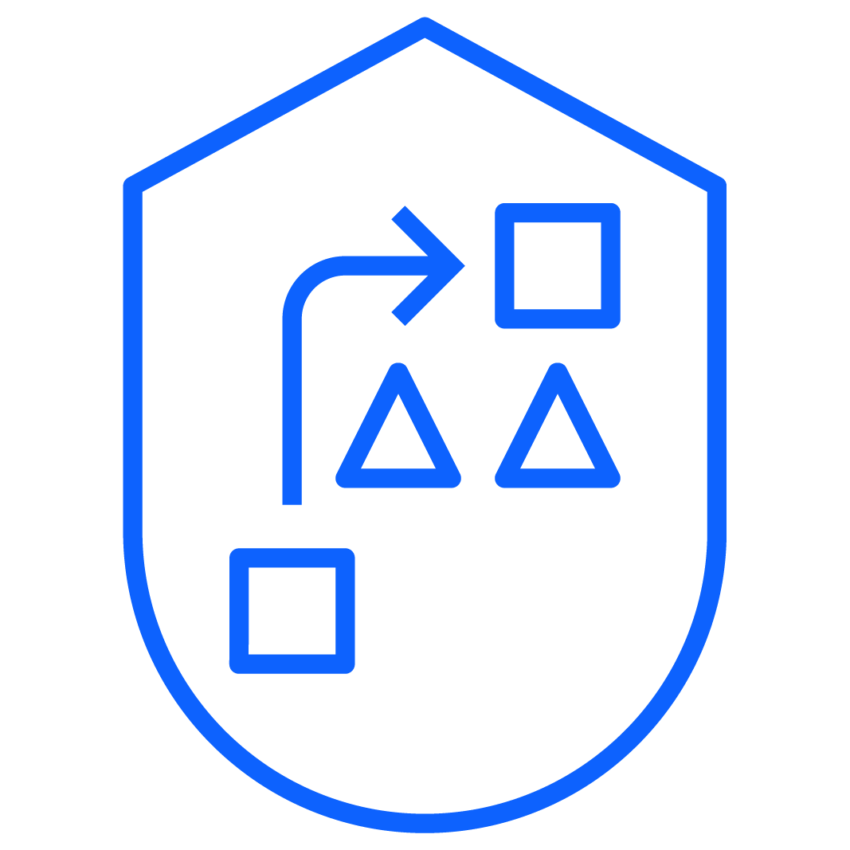
Proactive and predictive cybersecurity services
Execute a cybersecurity strategy and roadmap
Assess
Plan
Design
Build
Run
Assess
Plan
Design
Build
Run
Build, manage, and operate a sustainable and resilient program
Assess your cyber strategy and improve security effectiveness. Quantify risk in financial terms, while managing complexity from third parties and supply chain. Empower people through talent transformation and our cyber range.
Protect data, identities and workloads across hybrid cloud
Protect critical assets and processes, across data, quantum, key management, and DevOps. Govern identities from privileged to consumer. Secure platforms from cloud, SaaS and on-premise, to networks.
Predict, prevent, and respond to threats, without disruption
Prepare through exposure management and red teaming. Manage and modernize SecOps, with MDR capability across IT, OT, EDR, and cloud; enriched with X-Force Threat Intelligence and Global Incident Response and Remediation.
A foundation built on Zero Trust principles, and a reputation built on decades of clients
Supported by frameworks like NIST, ISO 27001, and DORA. Built on Security principles of Zero Trust and Risk Quantification. Powered by our Platform of AI and Automation.
Notes:
Here’s how we deliver end-to-end cybersecurity services, with the industry’s most comprehensive set of capabilities.
It begins with Cyber Strategy and Risk. That means having a strategy and an effective plan to achieve your business objectives and the security outcomes you seek. We address not only enterprise security, but ecosystem risk across third parties and supply chain.
We help clients achieve a continuous compliance posture, where annual or bi-annual compliance reporting evolves to more of a continuous compliance program operationalized through innovative tooling and processes.
In considering People Risk - It’s important for individuals in a company to understand the role they play in protecting the organization when the organization is breached. In this area we help train business leaders in cyber response and resiliency, enabling them to develop an effective leadership culture across the business and one that will permeate the entire organization.
To deliver trust, it is about protecting data, identities, workloads, and platforms across the hybrid cloud. Our cyber trust capabilities help clients modernize their identity access management infrastructure to extend across the hybrid cloud for both enterprise privileged users as well as consumers.
We have services which help clients discover the data, categorize it, and establish the correct controls for protection of the data. Our capabilities also help clients protect the platforms that the data, identities, and workloads operate upon - whether it's the hyper scalers or it's on-prem or SaaS properties.
We have services to take advantage of either cloud native security controls or, our own proprietary or third-party ecosystem partner tools to protect everything you see there in terms of platforms applications, identities, and data.
Finally our Cyber Threat Management IBM Security operates security operations for thousands of clients around the world through a managed services operation. Our collective aim is to enable our clients to mature and modernize their security operation centers.
With our Exposure Management capabilities, we help clients identify where they're vulnerable, prioritizing their vulnerabilities based on a risk-based approach and we help them automate the remediation of those vulnerabilities. Our X-Force Threat Intelligence services have global feeds from which we can identify potential threat actors, together with the tactics and tools they use, so that we can help clients prevent those attacks.
Lastly, it's not enough to have an Incident Response capability - organizations need to practice and be prepared to respond and so we help clients prepare for the inevitable breach as well as help to build in Incident Response plans, and test those plans as frequently as required by our clients.
Across our Cybersecurity Services portfolio, we leverage industry frameworks like NIST and ISO as well as other regulatory frameworks. And we leverage principles, like zero trust frameworks and risk quantification to help our clients, achieve their security outcomes,
Finally, we incorporate a full life cycle approach – encompassing consulting, integration, and managed services across the assess/plan/design/build/run lifecycle.

Slide 29

Threat Detection and Response Services
Execute a cybersecurity strategy and roadmap
Reduces critical vulnerabilities by 60% in just four months by partnering with the IBM X-Force Red team
A large global bank
Accelerate your threat detection and response strategy
ibm.com/case-studies/large-global-bank-security
Operationalize an enduring security strategy to protect against growing threats across domains, including OT/IoT/IoMT
Utilize AI-driven prioritization, managed security services, and our team of experts and leading partner ecosystem
Improve cross-domain threat visibility, investigation and response with automated root cause telemetry analysis
Optimize existing investments and accelerate your detection and response based on pre-integrated QRadar XDR suite (including ReaQta)
IBM X-Force Red
Penetration testing
Vulnerability management
Adversary simulation
Application security
IBM X-Force Incident Response
Incident response preparedness services
24x7x365 emergency incident response support
Threat hunting
IBM X-Force Threat Intelligence
Threat intelligence insights, sharing platform
Threat program assessments
Dark web analysis
Malware reverse engineering
IBM Security Cyber Range
Simulated breach experiences
Crisis and design thinking workshops
Executive briefings
Centralized SOC Shared Services and Intelligence Center
Notes:
Too often, an uncoordinated collection of threat detection and response tools built over time fails to deliver a comprehensive view that delivers secure operations.
IBM Services offers an intelligent, integrated unified approach to help you detect advanced threats, quickly respond with accuracy, and recover from disruptions.
Programmatic framework: Gain a 360-degree view of threat detection and response through an industry-proven, comprehensive framework for your organization.
Global threat detection and response expertise: With IBM Security X-Force® Threat Detection and Response services, your organization has access to thousands of global researchers, developers, analysts and SOC personnel for market-leading protection of your most critical assets.
AI and orchestration: Event enrichment, automated analysis and orchestration, enabling rapid threat response, powered by IBM Watson® and IBM Security SOAR.
Leading technology ecosystem: Our technology and partners help ensure your threat detection and response solution delivers on all fronts.
Speed and visibility: Respond from a mobile app with industry-leading service-level agreements, getting the information you need when you need it.
Protection across domains: Provides end-to-end for increasing threat vectors across operational technology (OT), Internet of Things (IoT) and Internet of Medical Things (IoMT).
Our team of experts knows how to prevent, detect, respond to, and recover from incidents quickly so you can focus on business priorities.
Our IBM X-Force Expert Services are backed by more than one thousand world-class hackers, responders, researchers, and analysts with decades of experience and a deep understanding of how threat actors think, strategize and strike.
X-Force Red provides offensive testing services to uncover high risk vulnerabilities and remediate them quickly.
X-Force Incident Response reduces the impact of a breach and improve resiliency to attacks.
X-Force Threat Intelligence helps you stay current on today's threat actors and indicators. Our intelligence is gleaned from IBM incident response client engagements, combined with all-source threat actor analysis; and infused in all IBM Security products and services to help clients stay ahead of attacks.
Our cyber ranges help hone your incident response and security leadership skills.
IBM Security Client Case Study: A large global bank: https://www.ibm.com/case-studies/large-global-bank-security

Slide 30


IBM Data and Application Security Services
Execute a cybersecurity strategy and roadmap
Consulting, systems integration,
and managed security services to help protect your critical data and applications, wherever they reside
ibm.com/case-studies/NHS
Minimizes business disruption from data loss
Gain visibility and knowledge through data discovery and classification and develop a security control framework for end-to-end protection of business-critical data
Simplifies regulatory compliance
Monitor users and application access to data and quickly adapt to changing global privacy regulations and maintain compliance
Leverages DevSecOps practices
Unify DevOps and security processes to help transform DevSecOps practices to identify and remediate application vulnerabilities earlier in the software development lifecycle
“Partnering with IBM allows NHS Digital’s Data Security Centre to develop and grow faster to help keep patient information and services safe and secure.”
- Rob Shaw, Former Deputy CEO and Sr. Information Risk Owner NHS Digital
Notes:
As your enterprise continues to adopt cloud and migrate its data and applications to hybrid cloud environments, the cyberattack surface significantly expands, increasing the risk of data breaches to threaten your business continuity and regulatory compliances.
To address this challenge, an effective cybersecurity program requires a data-centric approach that takes into account both data and application security practices – along with ….
Minimizing the business disruption from data loss
Simplifying regulatory compliance activities
And Leveraging DevSecOps practices:
And When considering the task to design and implement your data security strategy, we can help you do it or do it for you – across the spectrum, we can design and implement your data security strategy, and we can run it for you – releasing the burden of managing data complexity as it spins up to the cloud and across your organization. Further, As new applications rollout we can help onboard the data related to those applications into the data protection system (data encryption, classification, monitor data activity).
Mergers and acquisitions, are a common scenario where we can help manage the location of your data when you are putting two previously disconnected companies in under the same roof.
NHS Case Study: https://www.ibm.com/case-studies/nhs-digital-security-services

Slide 31

IBM IAM Services
Execute a cybersecurity strategy and roadmap
Accelerate your IAM program with strategic advisors and deep technical expertise
Thousands of partner integrations, technology and service alliances
20+ years of expertise with global reach and localized expertise
Let IBM help you accelerate
Strategy and Design Plan | Define | Design
Develop the right approach
Transform Build | Test | Enable
Ensure successful migration
Optimize Operate | Enhance | Expand
Maximize benefits
IBM Identity as a Service LEADER
KuppingerCole’s Leadership Compass
A successful IAM program requires a security strategy that combines people, process and technology.
Notes:
IBM Security Identity and Access Management Services can help improve your IAM security posture by offering: – Strategic trusted advisors to your business – Deep IAM subject matter expertise – Worldwide presence and localized delivery – Industry recognized security software and systems – Leading security innovation and AI solutions – Enterprise Design Thinking practices and principles – Broader security technology ecosystem capabilities
Strategy and Design: Plan, Define, Design Develop the right approach
Design a user-focused solution and a realistic migration plan using enterprise design thinking methodology
Determine which applications and capabilities to configure and onboard
Assess overall cloud readiness of existing infrastructure and IAM processes
Standardize IAM processes using industry best practices
Transform: Build, Test, Enable
Ensure successful migration
Rapid deployment of IAM technology
Adapt workflows and processes
Test, prototype, and iterate rapidly using agile methodologies
Lower infrastructure costs quickly to build stakeholder confidence
Onboard applications, configure capabilities, and train end users
Phase the migration to minimize user disruption and drive adoption
Optimize: Operate, Enhance, Expand
Maximize benefits
Redeploy skilled team members to higher-impact tasks
Refine onboarding and documentation procedures
Realize new efficiencies with automated IAM processes
Collect user feedback for continuous improvement
Integrate new technology, and extend capabilities over time

Slide 32

IBM Digital Trust Acceleration Services
Execute a cybersecurity strategy and roadmap
Quickly align a Zero Trust strategy with your business and security objectives
Engage with our experts to…
Assess your current state | Determine future maturity | Prioritize gaps based on ROI | Plan a detailed roadmap and investment strategy
Pre-Assess
Initiate
Assess
Strategize
Plan
Execute your Zero Trust Security Strategy
Zero Trust Objectives
Use Case Selection
Current State Security Controls
Conceptual
Views
Gap
Analysis
Project
Definition
Roadmap
Engagement Start-up
Observations and
Findings
Zero Trust
Governance Model
Business Risk and Objectives
Target State Model
Business Case
Notes:
We’re also well equipped to provide service capabilities to assist your transformation journey…
IBM Security uses a collaborative approach to develop a zero trust improvement roadmap that aligns to your security, compliance and operational priorities.
IBM digital trust experts will help your team:
Align zero trust strategy approach with business and security objectives
Assess current state, determine future maturity and prioritize gaps based on ROI
Build detailed roadmap and investment plan
…All in a matter of weeks.
Again, regardless of where you are on your zero trust journey – We can help you get started on that implementation plan or leverage our tools, services and expertise to accelerate your journey. ________
Zero Trust is a framework strategy that instructs security to:
Establish a state of least privilege -- so no user or app has any more access than what’s needed.
Verify continuously, as apps and users access data and tools.
And finally, to always assume a breach.
If done right, Zero Trust can do more than just prevent bad things from happening. It can deliver real business outcomes:
It can help reduce security risks associated with hybrid cloud modernization, which enables faster cloud adoption.
It allows seamless user authentication, from any device, so employees can be more productive.
It helps improve business continuity through reducing attack risks, and
It can enable organizations to build trust and improve customer experiences by maintaining compliance and privacy mandates.

Slide 33


Du partners with IBM Services to reduce risk and boost IAM efficiency
Execute a cybersecurity strategy and roadmap
The IBM Security Services solution improves business efficiency by onboarding new users and applications in days rather than weeks or months and reducing related help desk tickets by 80%
ibm.com/case-studies/du
“ IBM built a platform that addresses the unique needs of a telecommunications company by standardizing user access across IT and network operations.”
Ibrahim al Mallouhi, VP of Security Operations, du
Notes:
Protecting network resources and client data from unauthorized access while boosting efficiency
IBM Security Services helps du reduce risk and boost efficiency with an automated, centralized platform for identity and access management.
Business Challenge story
With a largely outsourced workforce, du needed an efficient way to protect network resources and data from unauthorized access, enhance the user experience, boost productivity and help reduce fraud.
Transformation
IBM helped du improve security and control with an automated, centralized IAM framework that provisions, monitors and optimizes user access to both IT business apps and network operations.
Benefits
The IBM Security Services solution improves business efficiency by onboarding new users and applications in days rather than weeks or months and reducing related help desk tickets by 80%. Du Client Case Study: https://www.ibm.com/case-studies/du

Slide 34
Accelerate security with an open architecture, AI and intelligence
Security that moves with your business
Notes:
Now let’s talk about how we deliver security that moves with your business.

Slide 35


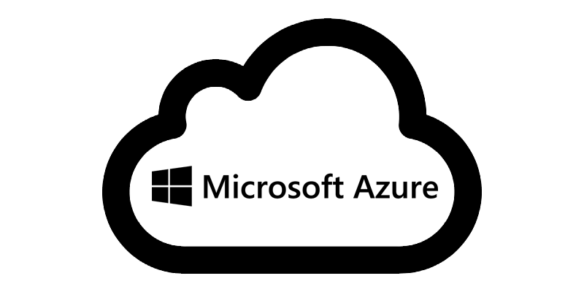
Save time and gain insights using an open security platform
Accelerate security with an open architecture, AI and intelligence
Integrate across people, processes, and products using open standards and best practices
QRadar
Threat Detection and Response
Guardium
Data Security
Common User Experience
Easily connect modular IBM and 3rd party products for cross-domain context
Share analytics
Centralize visibility with data lake and federated search
Access global threat intelligence
Respond with centralized case management, and automated playbooks
Verify
Identity Management
Trusteer
Fraud Protection
Security Products
MaaS360
Unified Endpoint Management
Open Ecosystem
3rd Party Solutions
Threat & Asset Intelligence
Open Security Platform
Notes:
[Presenter: This context diagram visualizes how IBM Security delivers its portfolio of solutions and services on a modern, open and unified security platform and how our approach benefits clients.]
66% of security teams do not share data across tools, 45% require security engineers to hand wire integrations
IBM Security offers an open, unified approach that integrates across people, processes, and products to save time and gain cross-domain insights.
We’ve been committed to evolving our portfolio and delivering it all on this common platform since our acquisition of Red Hat.
This open security platform, along with our consulting and managed services expertise, is designed to help clients:
Gain deeper security insights by connecting tools – whether IBM or 3rd party, and data – wherever it lives.
Respond faster to security incidents with AI and automation built-in.
And can run anywhere using a modern and modular approach to offer flexibility, extensibility, and avoid vendor lock-in.

Slide 36

X-Force Threat Intelligence
Accelerate security with an open architecture, AI and intelligence
IBM X-Force’s automated technologies and teams monitor threats around the globe by mining billions of data points to expose today’s most urgent security statistics and trends:
To infuse security products with reliable, concrete, actionable intelligence
To provide the intelligence your security team needs for rapid identification, investigation and remediation of compromise
To block the known malicious, before it impacts you
“Threat Intelligence should be a core part of the modern security operations center and security programs that underestimate the value of it will find it hard to effectively mitigate threats”
- Gartner
Malicious domains identified 8 days earlier than other threat intelligence providers¹
¹ Average days validated through continuous automated testing
36
Notes:
IBM Security X-Force Threat Intelligence combines IBM security operations telemetry, research, incident response investigations, commercial data, and open sources to aid clients in understanding emerging threats and quickly make informed security decisions.
The X-Force Exchange
The X-Force Threat Intelligence Insights
Advanced Threat Protection and Premier Threat Intelligence
Strategic Threat and Cyber Threat Intelligence Assessments
Dark Web Analysis, Malware Reverse Engineering
IBM X-Force Exchange
Cloud-based threat intelligence sharing platform enabling users to rapidly research the latest security threats, aggregate actionable intelligence and collaborate with peers.
IBM X-Force Exchange is supported by human- and machine-generated intelligence leveraging the scale of IBM X-Force.
36
IBM Security / © 2021 IBM Corporation

Slide 37



IBM Security at a glance
Accelerate security with an open architecture, AI and intelligence
Global enterprise security provider
Recognized leadership in 17 security segments
8,500+ total employees across 130 countries; including 1,000 world-class hackers, responders, researchers, and analysts with decades of experience
24 security acquisitions in 23 years
Hybrid cloud and AI security innovator
Threat Management
Data Security
Identity and Access
Fraud Protection
Security Strategy, Risk and Compliance
Cloud Security Services
Trusted advisor to thousands of clients
Security consultancy
Managed security services provider
Technology provider
an IBM Company
an IBM Company
an IBM Company
Notes:
[Presenter: This slide is optional, but important for clients who have little understanding of who we are and the makeup of our business. Slide was designed to set us apart from most of the security vendors, so let’s not be shy. We should come across as an innovator and trusted advisor unlike others.]
IBM security is one of the largest cybersecurity vendors on the planet – built for scale, innovating in key areas, and trusted by the most demanding organizations, including banks, airlines, transportation systems, electrical grids, mobile networks, and healthcare.
When we show up, we bring decades of threat intelligence expertise, new innovations, and reach that help solve the hardest cyber security challenges and deliver client-driven outcomes.
[Presenter: Please note the market leadership ranking’s reports may not be available to you, depends on your level of access] Security Analytics Platforms
SIEM, Gartner Magic Quadrant: https://www.ibm.com/account/reg/us-en/signup?formid=urx-51774
SIEM, IDC MarketScape: https://www.ibm.com/downloads/cas/M4PZJPLX
SIEM, KuppingerCole Leadership Compass: https://www.kuppingercole.com/research/lc80473/intelligent-siem-platforms
SOAR, KuppingerCole Leadership Compass: publishing 1/23
Incident Response
Cybersecurity Incident Response Services, IDC MarketScape: https://www.ibm.com/account/reg/us-en/signup?formid=urx-51373
Managed Security Services
Global Managed Security Services: https://www.ibm.com/account/reg/us-en/signup?formid=urx-46508
Global IT Security Services Provider, Omdia Universe: https://www.ibm.com/account/reg/signup?formid=urx-50072
Worldwide Managed Could Security Services, IDC Marketscape: https://www.idc.com/getdoc.jsp?containerId=US48761022&pageType=PRINTFRIENDLY
APAC Professional Security Services, IDC MarketScape: https://www.idc.com/getdoc.jsp?containerId=AP49101123
APAC MSSP, IDC Marketscape: https://www.idc.com/getdoc.jsp?containerId=AP49101222
Identity and Access Management
Identity Governance and Administration 2022, KuppingerCole Leadership Compass: https://www.ibm.com/account/reg/us-en/signup?formid=urx-47506
Access Management 2022, KuppingerCole Leadership Compass: https://plus.kuppingercole.com/reprints/12cba334d65c67a71f822fed84ff9b92?pdf=1#article-slice-16946
Identity as a Service - IGA 2021, KuppinerCole Leadership Compass: https://plus.kuppingercole.com/article/lc80511/identity-as-a-service-idaas-iga#article-slice-18883
Customer Identity & Access Management, Forrester Wave: https://www.ibm.com/account/reg/us-en/signup?formid=urx-48035&_ga=2.99274010.546766800.1603890153-624133264.1597172160&cm_mc_uid=80920728063115971721598&cm_mc_sid_50200000=18675891603903683808
Risk-Based Authentication, Forrester Wave: https://www.ibm.com/account/reg/us-en/signup?formid=urx-44981&_ga=2.214687255.185750477.1638564917-347013689.1638564917
Fraud Reduction Intelligence Platform, KuppingerCole Leadership Compass: https://plus.kuppingercole.com/article/lc80488/fraud-reduction-intelligence-platforms#article-slice-18323
CIAM Platforms 2022, KuppingerCole Leadership Compass: https://www.kuppingercole.com/research/lc80466/ciam-platforms
Identity Fabrics 2022, KuppingerCole: https://www.kuppingercole.com/research/lc80917/identity-fabrics
Passwordless Authentication 2022, KuppingerCole Leadership Compass: https://www.kuppingercole.com/research/lc81215/passwordless-authentication
Unified Endpoint Management
Unified Endpoint Management 2021, KuppingerCole Leadership Compass: https://www.kuppingercole.com/research/lc80518/unified-endpoint-management-uem-2021
IDC MarketScape Worldwide Unified Endpoint Management Software 2022: https://www.idc.com/getdoc.jsp?containerId=US48325322&pageType=PRINTFRIENDLY
Data Security
Data Security & Database Security, KuppingerCole Leadership Compass: https://www.ibm.com/account/reg/us-en/signup?formid=urx-40252&_ga=2.256554379.185750477.1638564917-347013689.1638564917
Data Center Backup & Recovery, Gartner’s Magic Quadrant: https://www.ibm.com/blogs/systems/ibm-leader-gartner-magic-quadrant-data-center-backup/ <IBMers, for more information, see https://w3.ibm.com/w3publisher/ibm-analyst-relations/business-areas/security>

Slide 38

Let’s take a next step with IBM Security Workshops
Accelerate security with an open architecture, AI and intelligence
Attend a no-cost interactive workshop to help uncover opportunity and identify next steps to increase your security maturity and mitigate risk
Framing and discovery workshops for new customers
XDR, Zero Trust, and Ransomware Framing and Discovery
Security Maturity Reviews
Security Architecture Reviews
Assessments for existing customers
Value Assessments by product
Cyber-Resilience Assessments
ibm.com/security/resources/workshop
Notes:
How are you planning to protect your business with a cybersecurity strategy that meets the sophistication of today’s threats?
To learn more about how to best protect against hackers and build your cyber-resilience, request a no-cost security workshop to help you understand your organization’s cybersecurity landscape and prioritize initiatives.
Customized agenda
Approximately a 3-hour interactive design thinking session
Includes 5-7 participants across functions
Receive a custom report that highlights the areas of opportunity and next steps to increase maturity and mitigate risk
<IBM Presenter: For more information see W3: https://w3.ibm.com/w3publisher/ibm-security-americas/customer-workshops>

Slide 39
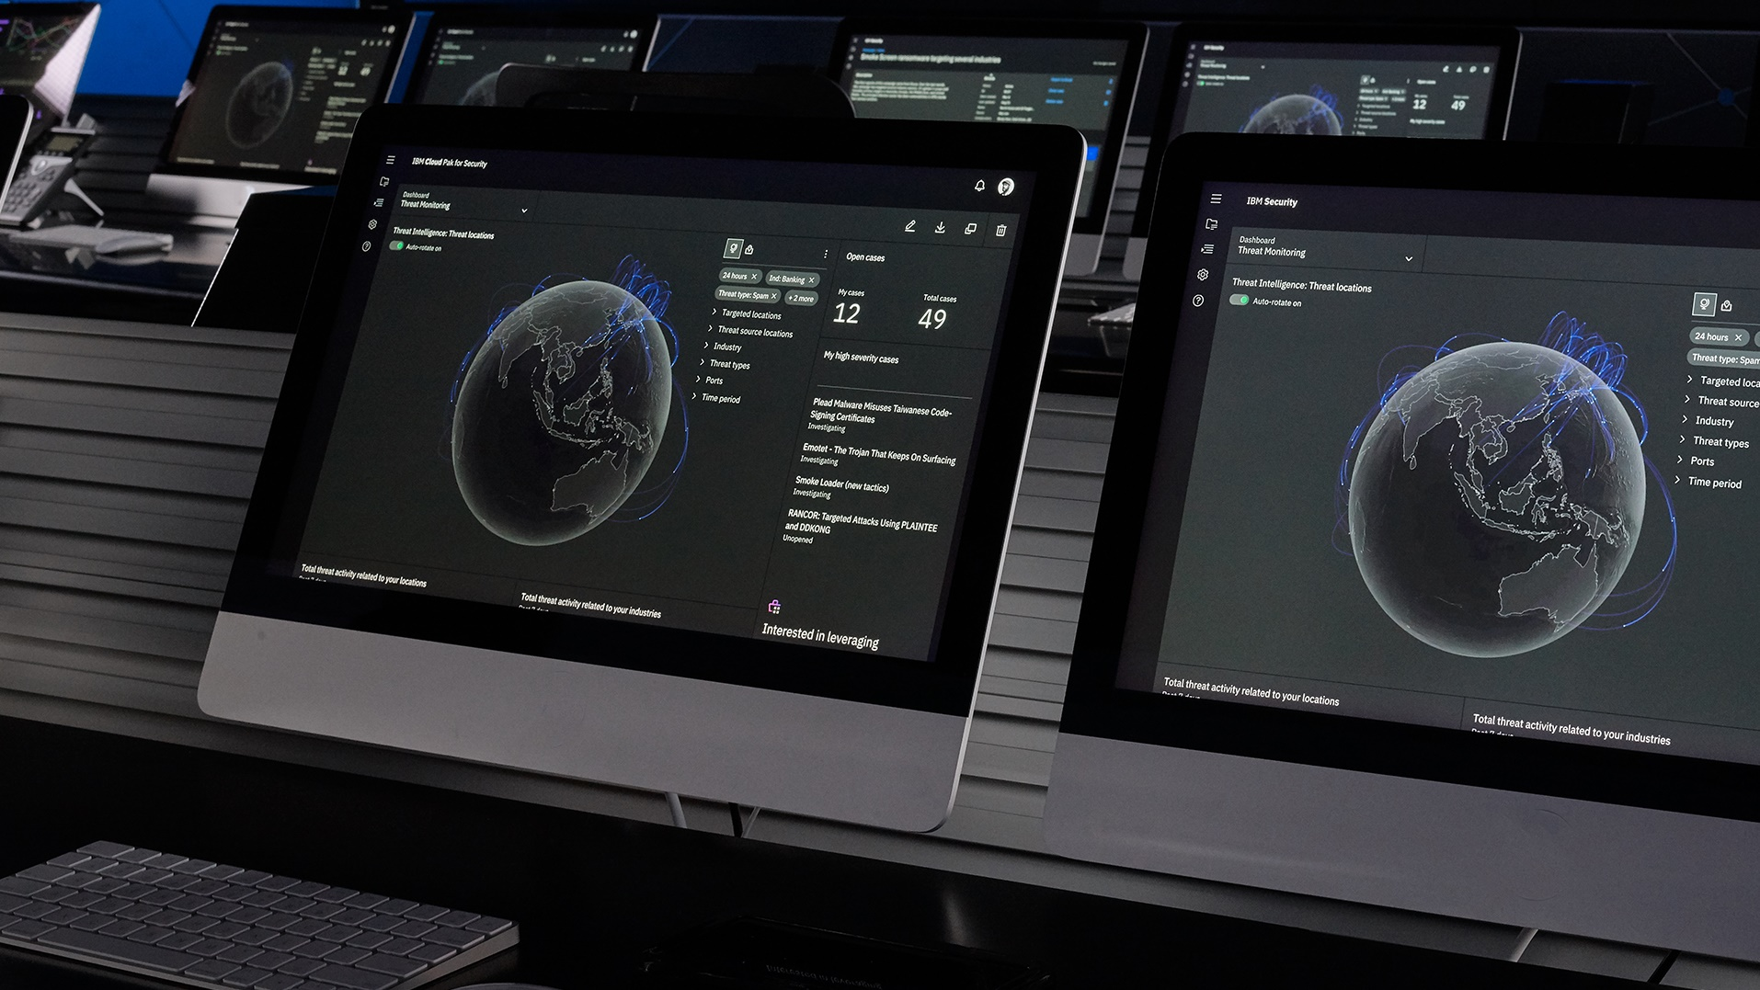


Cybersecurity threat resources related to the Russia-Ukraine war
IBM Security resources to help support your organization with crisis management
Book a one-on-one consultation to build a plan
ibm.com/security/resources/crisis-management
If you are experiencing cybersecurity issues or an incident, contact X-Force to help.
Attend A FREE Security Framing Workshop ibm.biz/FramingWorkshop
US hotline 1-888-241-9812
Sign-up for IBM X-Force Exchange exchange.xforce.ibmcloud.com
Global hotline (+001) 312-212-8034
Notes:
[Presenter: This “Call to Action” slide offers clients a free briefing on the latest threat intelligence the IBM X-Force team gathered on the Russian war in Ukraine and recommended actions organizations should be taking to guard against state sponsored cyberattacks. It also offers clients the opportunity to engage with IBM Security experts in a free Zero Trust workshop.]
IBM Security X-Force is currently in heightened vigilance status and is closely monitoring the escalating Russia-Ukraine war, including the evolving attacks and malware observed in the cyber domain. As this cybersecurity threat develops,
The IBM Security X-Force team has been meeting with clients worldwide to discuss the latest threat information we have analyzed, and most importantly, what companies should be doing today to reduce their risk of a compromise.
If you need help in certain areas of your offensive and defensive security programs to prepare for potential attacks, our team is happy to hold a one-on-one briefing with your team, at no cost. We also have created several resource pages to help our clients prepare. They can be found here:
https://www.ibm.com/security/resources/crisis-management

Slide 40
Thank you
© 2023 International Business Machines Corporation IBM and the IBM logo are trademarks of IBM Corporation, registered in many jurisdictions worldwide. Other product and service names might be trademarks of IBM or other companies. A current list of IBM trademarks is available on ibm.com/trademark. This document is current as of the initial date of publication and may be changed by IBM at any time. Statements regarding IBM’s future direction and intent are subject to change or withdrawal without notice, and represent goals and objectives only. THIS DOCUMENT IS DISTRIBUTED “AS IS” WITHOUT ANY WARRANTY, EITHER EXPRESS OR IMPLIED. IN NO EVENT, SHALL IBM BE LIABLE FOR ANY DAMAGE ARISING FROM THE USE OF THIS INFORMATION, INCLUDING BUT NOT LIMITED TO, LOSS OF DATA, BUSINESS INTERRUPTION, LOSS OF PROFIT OR LOSS OF OPPORTUNITY. Client examples are presented as illustrations of how those clients have used IBM products and the results they may have achieved. Actual performance, cost, savings or other results in other operating environments may vary. Not all offerings are available in every country in which IBM operates. It is the user’s responsibility to evaluate and verify the operation of any other products or programs with IBM products and programs. The client is responsible for ensuring compliance with laws and regulations applicable to it. IBM does not provide legal advice or represent or warrant that its services or products will ensure that the client is in compliance with any law or regulation.
Notes:
<Mandatory closing slide>

Slide 42
But security leaders face accelerating threats and change
27%
of attacks were from threat actors seeking to extort money
58%
of phishing kits sought passwords from users, which are more sought after than credit card numbers
21%
of incidents saw backdoors deployed as the top objective of attackers following successful breach
70%
Have experienced at least one cyber attack through the exploit of an unknown, unmanaged, or poorly managed internet-facing asset
$4.45M
Average cost of a data breach, up 15% in three years
Sources: 2023 IBM X-Force Threat Intelligence Report, 2022 The State of Attack Surface Management Report, 2023 IBM Security Cost of a Data Breach Report
Notes:
[Presenter: Key takeaways from our latest threat intelligence reports to get the blood flowing in any meeting.]
But moving fast is tough given the accelerating threats and change security leaders are faced with. Cybercriminals are constantly adapting their tactics to infiltrate every business across all industries and countries, posing tremendous uncertainty to businesses and individuals alike.
We’re witnessing attacks and threats that are on the rise across all environments last year
Attack surfaces are expanding beyond the traditional perimeters
And the cost of a data breach is up 13% in two years
We also recognize that in addition to threats increasing, so does the number of compliance requirements organizations face.
It’s time to face this mounting uncertainty head on and gain an advantage to move ahead, and we’re here to help… <Additional statistical details>
IBM X-Force Threat Intelligence reported that in 2022…
27% of attacks using extortion methods. Threat actors sought to extort money from victims in more than one quarter of all incidents to which X-Force responded to in 2022. The tactics they use have evolved in the last decade, a trend expected to continue as threat actors more aggressively seek profits.
58% of phishing kits sought passwords from users; Kits requesting credit card data saw 52% year-to-year decline
21% of incidents saw backdoors deployed which was the top action on objective lasts year; occurring in more than one in five reported incidents worldwide. Successful intervention by defenders likely prevented threat actors from fulfilling further objectives that may have included ransomware.
And according to the 2022 State of Attack Surface Management Report, 70% of organizations have experienced at least one cyber-attack through the exploit of an unknown, unmanaged, or poorly managed internet-facing asset.
And according to the 2023 IBM Security Cost of a Data Breach Report, $4.45M is the global average cost of a data breach (up 15% in 5 years); US has the highest country average at $9.48M (for 13th year in a row); And it takes 292 days on average to respond to a breach when data was stored across multiple environments, 15 days longer than the overall average for containing a breach.
Sources: 2023 IBM X-Force Threat Intelligence Report: https://www.ibm.com/reports/threat-intelligence 2022 The State of Attack Surface Management Report: https://www.randori.com/reports/the-state-of-attack-surface-management-2022/ 2023 IBM Security Cost of a Data Breach Report: https://www.ibm.com/security/data-breach

Slide 43





Security leaders are moving to a Zero Trust approach
Business benefits of becoming a Zero Trust Enterprise
As risks evolve and new threats emerge, traditional security models that rely on defined perimeters and implicit trust are becoming obsolete
Zero Trust is a dynamic approach to security where defenses move from static, network-based controls to focus on users, assets, context, and resources
Core principles of Zero Trust
Establish least privilege
Verify continuously
Assume breach
The average cost of a breach was $1.76M less at organizations with a mature Zero Trust approach¹
Faster cloud adoption
More productive employees
Improve business resiliency and continuity
Build trust and positive customer experiences
¹ IBM Security Cost of a Data Breach Report 2021
Notes:
The average cost of a breach was USD 1.76 million less at organizations with a mature zero trust approach, compared to organizations without zero trust.
Security leaders are looking to build an enduring security program built with a zero trust strategy.
Zero Trust is a framework strategy that instructs security to:
Establish a state of least privilege -- so no user or app has any more access than what’s needed.
Verify continuously, as apps and users access data and tools.
And finally, to always assume a breach.
If done right, Zero Trust can do more than just prevent bad things from happening. It can deliver real business outcomes:
It can help reduce security risks associated with hybrid cloud modernization, which enables faster cloud adoption.
It allows seamless user authentication, from any device, so employees can be more productive.
It helps improve business continuity through reducing attack risks, and
It can enable organizations to build trust and improve customer experiences by maintaining compliance and privacy mandates.

Slide 44



IBM Centralized SOC Shared Services and Intelligence Center
Security that moves with your business
Shared Services SOC
ASM
EDR
SIEM
SOAR
Attack Surface Management
Endpoint Detection & Response
Security Information & Event Management with NDR and UBA
Security Orchestration Automation & Response
Leverage SOC shared services
Leverage existing tools with Central SOC
Gather alerts from 3rd party solutions
Leverage advanced analytics and correlation
Automate threat hunting, incident response triage and analysis
Perform 3rd party triage and telemetry analysis
Leverage dynamic SOC response workflow
Obtain threat reports across all SOCs
Subscribers’ SOCs and 3rd Party Tools
Notes:
Security teams need efficient centralized visibility to combat “weakest link” attacks. Whether you’re a government entity, MSSP, or Corporate conglomerate providing centralized shared services there is no easy solution. Shared services are inherently complex but are essential to protect your organization from “weakest link” attacks.
Attackers purposely look for the “weakest link”, they will compromise a weak entity, with a relatively immature security practice. Once Attackers have compromised the “entry” organization, they will pivot, using resources and “account take over” to escalate to the “target” organization. One weak link or one exposed risk places the entire organization at risk.
In many ways a Shared Services SOC is modeled after MSSP practices. Shared services providers collect data from multiple “tenants” or service “subscribers”. These subscribers each have different requirements for response. Some subscribers need end-to-end response, others will just need “alert and notify”. The Shared Services SOC analysts either need to memorize dozens of workflows or need a tool to assist them.
Additionally, in many of these organizations, each subscriber has a different set of tools, different EDR, different SIEM’s, clouds, etc. This is important because services like Managed Detect and Response or threat hunting become increasingly difficult with the more products a shared services provider is supporting.

Slide 45
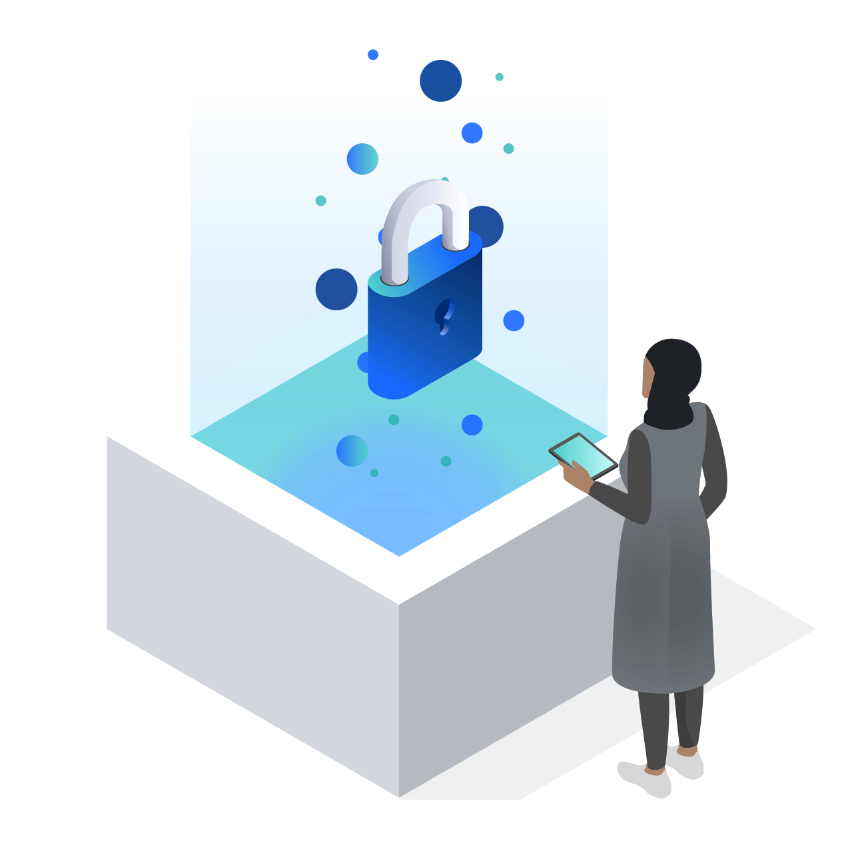
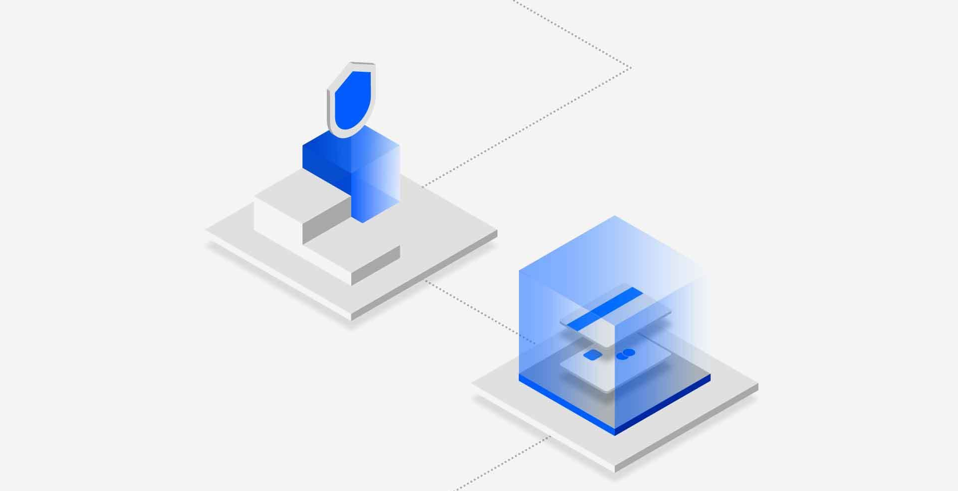
Automate and accelerate compliance to help support data security regulations
Security that moves with your business
Reduce audit prep time
75%
with automated compliance audit and reporting
Save up to
1000
hours of DBA time using automated processes
Faster compliance
Custom compliance policy, audit workflows, and reporting—as well as long-term data storage—help meet compliance goals faster
Cultivate customer trust
Adopt data protection and compliance best practices that help eliminate costly breaches and audit failures while building consumer loyalty and trust
PCI
SOX
HIPAA
Source: “The Total Economic Impact of IBM Security Guardium”, Forrester
GDPR
CCPA
Schedule a FREE Security Framing and Discovery Workshop for a technical review and address next steps
ibm.com/security/resources/workshop
Notes:
Today’s digital transformation and the pandemic have rapidly accelerated the shift of apps, workloads, and sensitive data to the cloud. This presents challenges for both compliance and data security as the volume and velocity of data distributed across hybrid cloud environments has grown exponentially.
Clients must identify, track, and secure regulated data (e.g., customer data, HR data, supplier data, etc.) at rest, and in motion, wherever it lives. At the same time, they must respond to compliance requests and reporting requirements. This can be overwhelmingly complex and exhaustingly time consuming to address, which can lead to costly data exfiltration and audit failures.
IBM Security can help clients continuously discover and classify structured and unstructured data, on-premises and in any cloud with solutions that provide:
A more contextual view of data through data flow mapping, and support Data Subject Request (DSR) needs.
Once data is discovered and classified, we have the right solutions to monitor and protect that data.
We provide next generation architecture and automated integration with the SOC to seamlessly support DSR needs, share relevant information, and trigger deeper investigation of possible compliance or breach incident.
Source: “The Total Economic Impact of IBM Security Guardium”, Forrester https://www.ibm.com/account/reg/us-en/signup?formid=mrs-form-2454
<Presenter: Key IBM Security Geography Subject Matter Experts>
EMEA – Brian Flasck brian.flasck@uk.ibm.com
Latin America -Alexandre Brandi Patarra apatarra@br.ibm.com
APAC – Shaibal Saha shaibal@sg.ibm.com
Americas/Worldwide – Ian Wight ianw@ibm.com

Slide 46
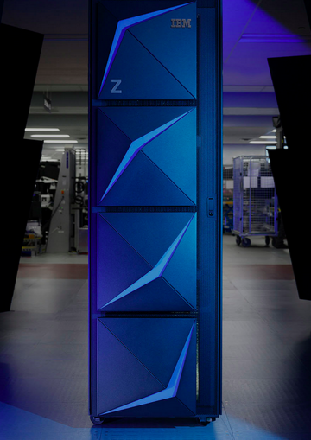



IBM Z Security for end-to-end security on the mainframe
Security that moves with your business
Make the most securable platform the most secure
Simplify and automate threat detection and response capabilities on the mainframe:
Enhance security intelligence
Detect and prioritize threats
Deliver timely alerts
Recommend closed loop remediation actions
Secure data across new cloud, mobile and big data apps without compromising production time or mission critical information
Integrate security admin and reporting for apps, transactions, data, and security products operating on the mainframe
Gain continuous security compliance readiness using pre-built goal validations, customized audit reporting
Raise the assurance level of user authentication with multi-factor authentication on the mainframe
Reduce audit prep time from one month to just one week¹
Threat Detection and Response
IBM Z Security
Data Security
Secures data for millions of banking customers while facilitating business agility
Identity and Access Management
ibm.com/case-studies/atruvia
¹IBM zSystems clients surveyed
Notes:
The collective IBM Z Security solution is designed to:
Provide comprehensive security solutions that enable new secure cloud, mobile and big data applications without compromising any production or mission critical information that already resides on the mainframe. Customers still indicate that security concerns are a top inhibitor to cloud implementations. Mainframes provide the ultimate security platform for cloud, mobile and big data applications.
Simplify and automate the analysis of the massive number of security related events to: detect potential threats, prioritize threats, customize audit reporting, deliver timely alerts, recommend closed loop remediation actions, and enhance the security intelligence for the mainframe.
Take the complexity and ambiguity out of compliance audits-A modern application specifically designed for progressing towards a state of continuous compliance readiness on IBM Z with pre-built goal validations and customizability.
Integrate security administration and reporting for mainframe applications, transactions, data and security products operating on the mainframe. This includes DB2, CICS, IMS, MQ, z/VM, Linux on z Systems and more.
IBM zSystems clients surveyed anticipate they can potentially reduce audit preparation timelines from one month to one week.
zSecure suite is a family of 8 products that helps to take the complexity our of mainframe security management, audit and compliance.
Z Multi-Factor Authentication for advanced authentication native to the mainframe, that also integrates with multi-platform, multi-cloud offerings for an “authentication everywhere” solution
And two offerings from the IBM Security portfolio that have mainframe specific capabilities:
Guardium data management
QRadar security intelligence and orchestration
Client case study: www.ibm.com/case-studies/atruvia
IBM Z Security on Seismic
Leverage quantum-safe technology
• From basic HW initialization, through multiple layers of firmware, quantum-safe cryptographic technology protections need to be leveraged.
• The system must provides quantum-safe capabilities over time to secure system layers such as operating system, virtualization, middleware, and applications.
IBM Z Security and Compliance Center (ZSCC)
IBM Z Security and Compliance Center (ZSCC)
Remove the complexity out of the IBM Z compliance workflow and the ambiguity out of audits through automated fact collection and mapping to comply with security standards It is a modern application specifically designed for progressing towards a state of continuous compliance readiness on IBM z16 with over 300 pre-built goal validations and customization's. Increase productivity of compliance resources by reducing audit preparation time for selected controls
Add new levels of security to your mainframe
The IBM zSecure Suite adds layers of security assurance — including audits, alerts, administration, reporting and authentication — that enhance the security and risk management in IBM Z® hardware, software, virtualization, and standard external security managers (ESMs) such as IBM RACF, CA ACF2, and CA Top Secret.
The zSecure Suite automates security administrative tasks to help increase efficiency and reduce errors, detects internal and external threats, issues real-time alerts, and monitors compliance.
<Presenter: This slide targets all IBM Z hardware, software, virtualization, and standard external security managers (ESMs) such as IBM RACF, CA ACF2, and CA Top Secret clients; and explains at a high level our full security for data on Z - encryption, authentication, visibility and monitoring zSecure suite.
Michael Zagorski, IBM Z Security (zSecure, zMFA, Guardium for Z)
IBM’s mainframe security portfolio includes:
- zSecure suite is a family of 8 products that helps to take the complexity our of mainframe security management, audit and compliance.
Z Multi-Factor Authentication for advanced authentication native to the mainframe, that also integrates with multi-platform, multi-cloud offerings for an “authentication everywhere” solution
And two offerings from the IBM Security portfolio that have mainframe specific capabilities:
Guardium data management
QRadar security intelligence and orchestration
All of these products leverage the substantial security capabilities offered by the IBM Z platform, such as RACF and pervasive encryption.
The collective IBM Z Security solution is designed to:
Provide comprehensive security solutions to that enable new secure cloud, mobile and big data applications without compromising any production or mission critical information that already resides on the mainframe. Customers still indicate that security concerns are a top inhibitor to cloud implementations. Mainframes provide the ultimate security platform for cloud, mobile and big data applications.
Simplify and automate the analysis of the massive number of security related events to: detect potential threats, prioritize threats, customize audit reporting, deliver timely alerts, recommend closed loop remediation actions, and enhance the security intelligence for the mainframe
Integrate security administration and reporting for mainframe applications, transactions, data and security products operating on the mainframe. This includes DB2, CICS, IMS, MQ, z/VM, Linux on z Systems and more
Atruvia case study: https://www.ibm.com/case-studies/atruvia
_____ The IBM Security zSecure products provide security, monitoring, auditing and alerting functionality on both the z/OS and z/VM platforms.
The main products are zSecure Admin and zSecure Audit. These products can be used alone or in conjunction with the other zSecure products
IBM Security zSecure Admin
Automate recurring, time-eating IT security management tasks
zSecure Admin enables you to automate time-consuming IT security management tasks by quickly identifying, analyzing, and preventing problems in IBM RACF. You can also monitor privileged users to help ensure old accounts are properly deleted and products have been integrated appropriately. zSecure Admin integrates smoothly with zSecure Audit for end-to-end monitoring and remediation.
zSecure Admin can administer multiple systems with a single application interface. You can compare profiles, efficiently merge security rules from different databases, or rename IDs within the same database. When merging profiles from different databases, zSecure Admin performs extensive consistency checks and reports potential conflicts before generating commands, helping ease the burden of consolidation efforts ad compliance automation.
For network access control, zSecure Admin provides capabilities for reporting on actual usage of profiles and authorizations and relates that to the information defined in the current RACF database. This highlights profiles and authorizations use in production, exposes user-to-resource relationships, and identifies unused or obsolete profiles and authorizations in access control lists.
IBM Security zSecure Audit
Measure and verify the effectiveness of your mainframe security policies and security compliance
Verifies mainframe security policies and security compliance
zSecure Audit helps you extend and enrich the existing Z Systems security (IBM RACF, CA ACF2, or CA Top Secret) by enforcing and enhancing security policies in repeatable, sustainable, and automated fashion. These automated reports also help you quickly locate vulnerabilities and compliance issues in strict security compliance environments such as for the Payment Card Industry Data Security Standard (PCI DSS), Security Technical Implementation Guide (STIG) and other similar standards
zSecure Audit can email customizable reports daily when specific events occur or when there is a potential security breach. Audit events and user access logs generated by IBM security management tools can be populated within Security Information and Event Management (SIEMs) tools such as IBM QRadar for normalization and compliance reporting.

Slide 47

Data security built into every layer of your infrastructure
Gain the flexibility needed to scale and accelerate your cloud infrastructure strategy without sacrificing security
IBM Cognitive Systems
Ensure platform integrity with secure and trusted boot
Deploy with a common security model across on-prem and IBM Cloud offering
Go beyond data backup and recovery using a cloud-native experience, cyber resilience, and always-on availability
IBM Storage
Safeguard point-in-time copies of data from being modified or deleted by adversaries
Protect data at rest and in flight with Fibre Channel Endpoint Security
Keep data secure, private, and encrypted as it moves between platforms across your hybrid multicloud environment
IBM Z
Protect system of record data with pervasive encryption
Enforce data protection and privacy with IBM Data Privacy Passports
Achieve confidential computing with Secure Service Container and Secure Execution for Linux
Embrace future technologies with quantum-safe cryptography and fully homomorphic encryption
84%
Get the cloud you want, with the privacy and security you need
IBM Cloud Hyper Protect Services Built on LinuxONE secure enclave technology with the industry’s only FIPS140-2 Level 4 cloud HSM
Hyper Protect Crypto Services
Hyper Protect DBaaS
Hyper Protect Virtual Servers
Lower TCI with an integrated out-of-the box security stack on IBM Z
Notes:
IBM Power Systems* servers have security built into the platform at all layers–processors, firmware, hypervisor, OS and system management.
Power Systems SMEs: Dimitrios Penderakis and Petra Bührer https://ibmsystemsmag.com/Power-Systems/08/2019/enhance-overall-security
84.21% lower TCI with IBM Z – This is primarily the difference between a highly integrated out-of-the-box security stack vs bolt-on architectures… Source: Solitaire Interglobal Study http://ftpmirror.your.org/pub/misc/ftp.software.ibm.com/common/ssi/ecm/zs/en/zsw03297usen/industry-platforms-unit-banking-integrated-risk-management-irm-ii-white-paper-external-zsw03297usen-20180424.pdf
______ https://www.ibm.com/it-infrastructure/solutions/security

Slide 48
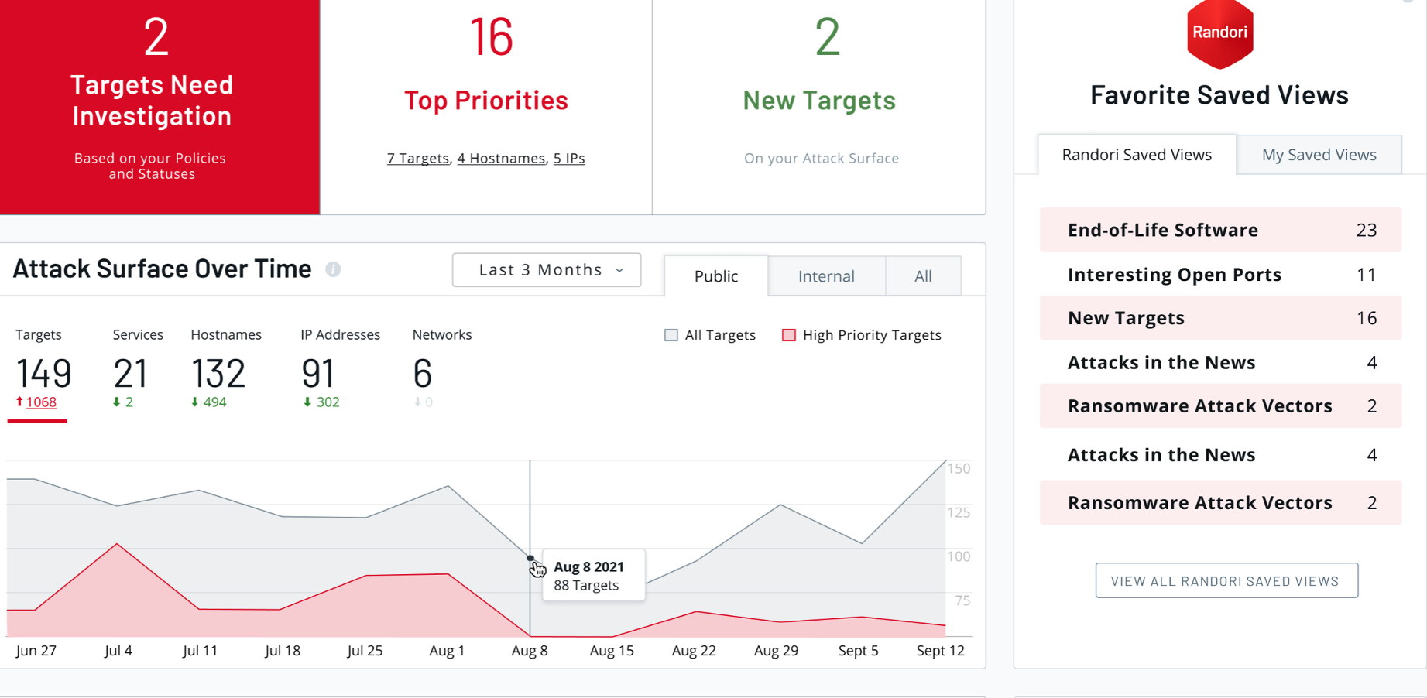


IBM Security Randori Recon
Predict, prevent, and respond to modern threats
ASM
Continuously identify external facing assets that are visible to attackers – and prioritize high-risk exposures
Saves 15 hours of work a week by eliminating the guesswork of triaging and prioritizing vulnerabilities
www.randori.com/case-studies/armellini
Deliver the attackers perspective
Help clients of all sizes better see what attackers see, before the damage is done
Accelerate offensive security services
Help clients test their defenses and incident response teams with continuous and automated red teaming
Enhance Extended Detection and Response (XDR)
Help clients detect and respond to threats faster with real-time insights of assets and weaknesses on their perimeter
Notes:
IBM acquired Randori in June of 2022, transforming how clients manage risk with Attack Surface Management. Randori bridges the gap between technology and service. Randori evolves XDR’s ability to GTM by providing views into the attack surface, and more robust add-on services, while offering X-Force Red a mature SaaS to complement and expand capabilities.
Different from asset discovery and asset management, attack surface management (ASM) – the continuous process of discovering, classifying and assessing the security of all of an organization's assets – approaches security tasks from an attacker's perspective. In today's cloud world, it is essential that organizations are armed with the attacker's perspective to ensure their security efforts maximize business stability, revenue and positive reputation.
Randori is a hacker-led company and pioneer in attack surface management, founded with the mission to ensure every organization has access to the attacker’s perspective. They do this with an offensive security platform that replicates the techniques attackers use to discover and attack organizations at scale. Customers use this platform to stay one step ahead by understanding their most risky exposures, validating controls, and optimizing their defenses in real-time.
Key to Randori is the idea of continuous improvement. Named after a jiu-jitsu term that means “practice how you fight,” the Randori team built a platform to get better with every new target they discover and each new attack runbook they develop. True to their namesake, they learn and adapt with customers.
Through this, they help customers adopt a more proactive security posture by helping them discover unknown exposures, better prioritize vulnerabilities, and validate their defenses in real-time so they can stay ahead of the next attack.
<Randori Details>
Randori is a hacker led company, with software to help security teams discover gaps, assess risks, and improve over time by delivering an unrivaled attack experience at scale. Founded in 2018, Randori has approximately 70 employees. Based in the Boston area with an office in Denver, Randori is a recognized leader in the Attack Surface Management market. They were named a Cool Vendor by Gartner and Innovator by IDC in 2021 and are a 2022 SC Award finalist for Best Vulnerability Management Solution. Backed by leading venture capital firms, including Accomplice, .406 Ventures, Harmony Partners and Legion Capital - Randori has raised nearly $30M in funding across two rounds. It is led by a seasoned leadership team that includes Co-Founder and CEO Brian Hazzard, an early employee at Carbon Black, David Wolpoff, Co-Founder and CTO, a former hacker for defense and commercial clients, VP of Engineering Ken Shelton, former VP of Engineer at Qualys, Director of R&D, Aaron Portnoy, who founded the Pwn2Own context, and Chief Strategy Officer, Retired Rear Admiral Dan MacDonnell, who previously served as Deputy Chief of the NSA/CSS. Trusted by leading global enterprise customers, Randori has dozens of customers including multiple Fortune Global 100 companies, leading retailers, banks, transportation and energy companies and has maintained industry-leading customer retention numbers with more than 100%+ net customer retention.
Client Case Study: Armellini Logistics: https://www.randori.com/case-studies/armellini/

Slide 49
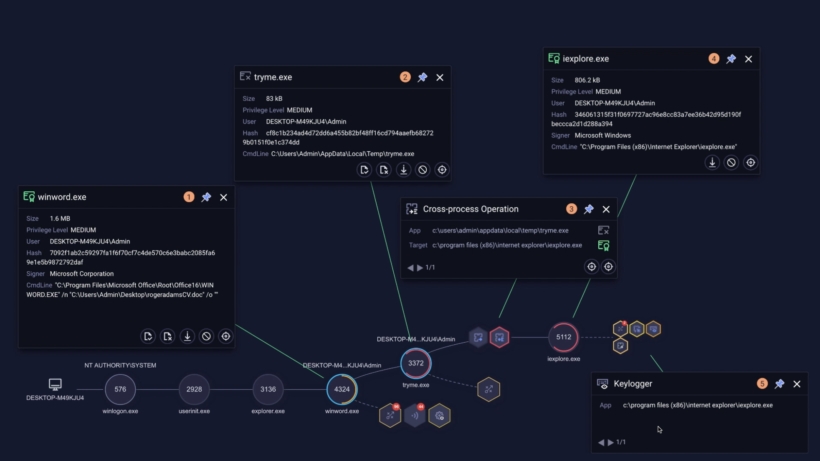
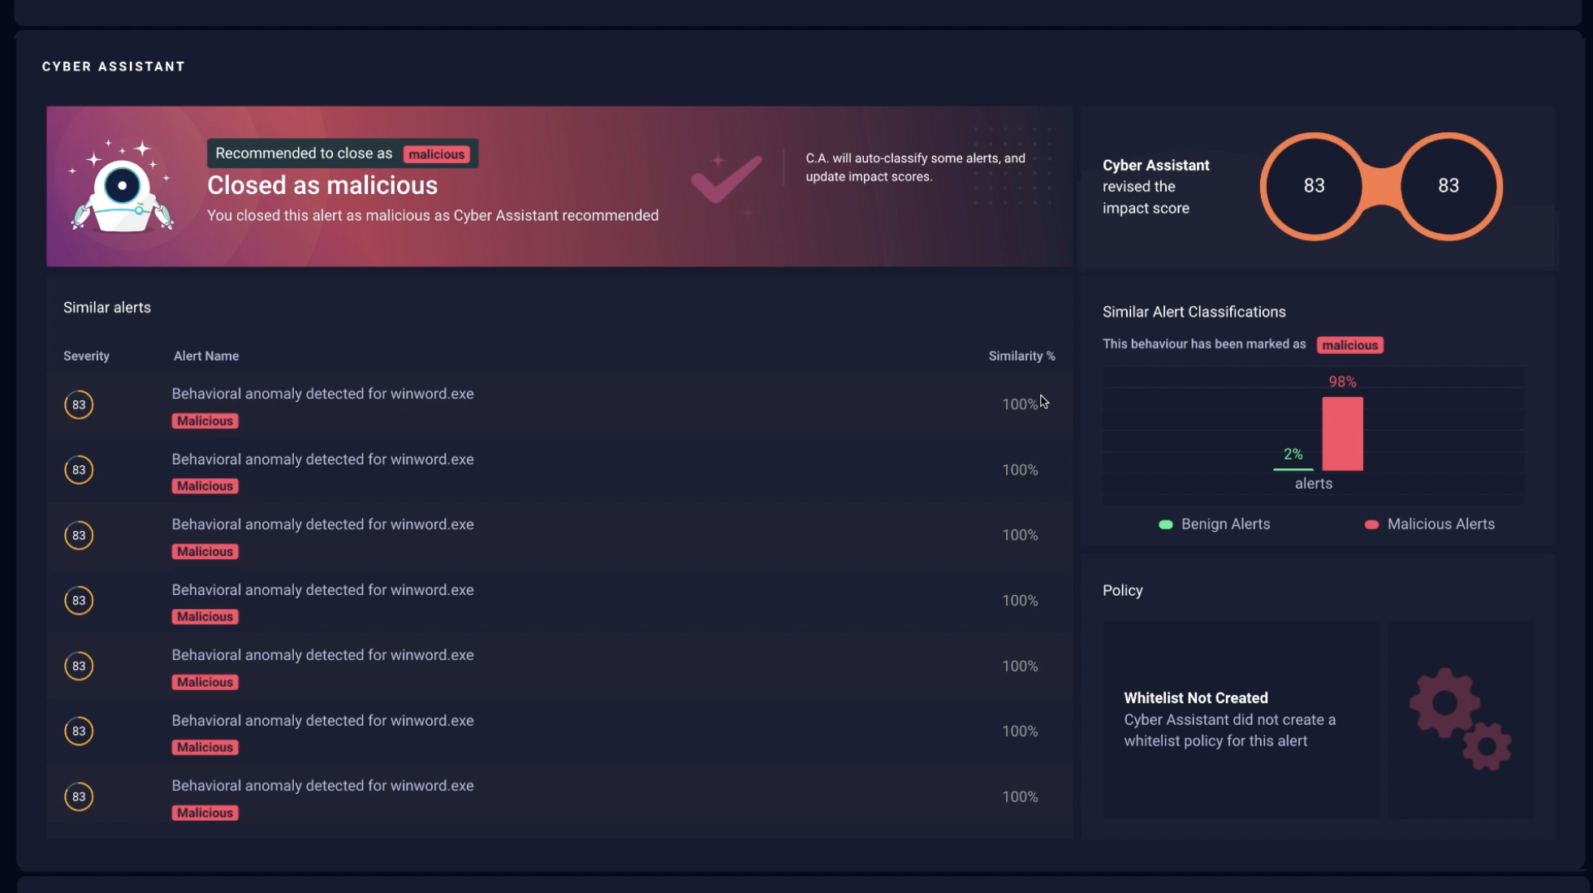
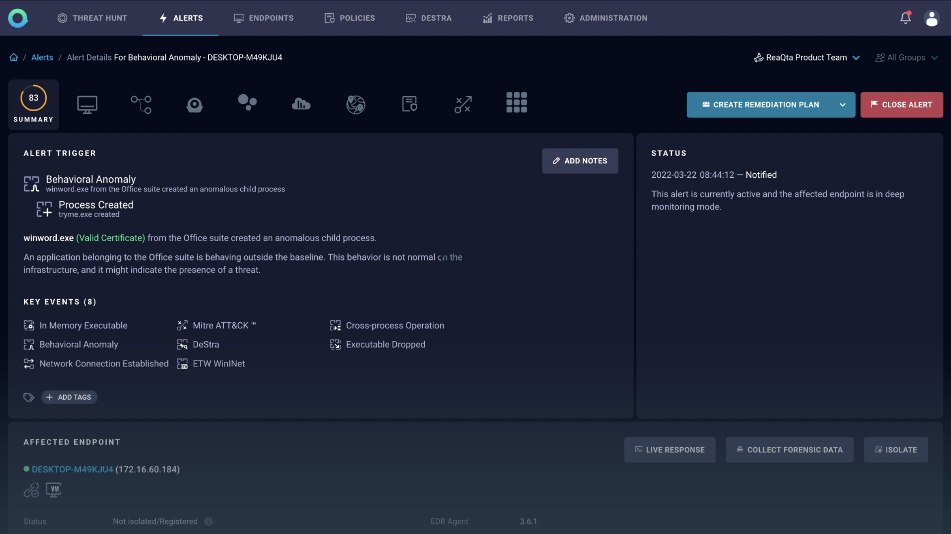
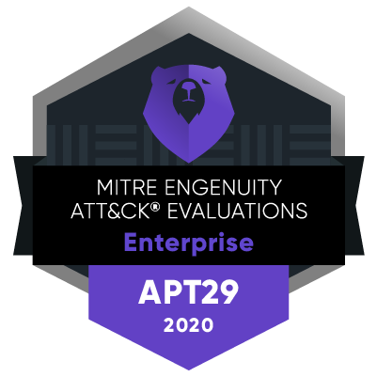
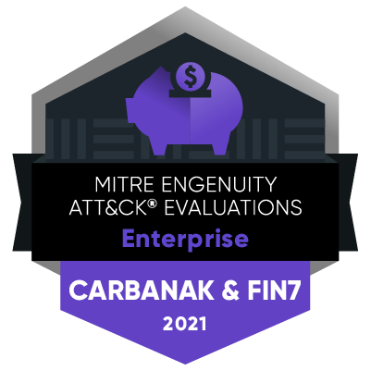
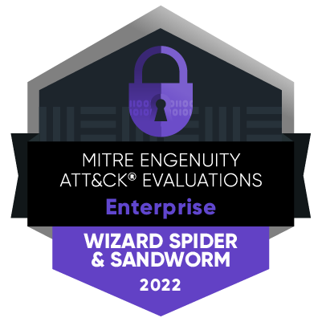

IBM QRadar EDR
Predict, prevent, and respond to modern threats
Gain a clear line of sight Regain full control over all endpoint and threat activity. Designed to be undetectable, NanoOS provides deep visibility into processes and apps running on endpoints
Automate your response
Our continuously learning AI detects and responds autonomously in near real-time to previously unseen threats, and helps with guided remediation and automated alert handling
Move from reactive to proactive
Get ahead of attackers with easy-to-create detection and response use cases that return results in seconds; Deploy use cases without interrupting endpoints uptime
Remediate known and unknown endpoint threats in near real-time with intelligent automation and AI, attack visualization storyboards, and automated alert management
MITRE ATT&CK Evaluations
100% real-time detection, without delay, across the kill chain
No configuration changes
Prevented 24 ransomware attacks in just three months, and tracked and remediated dozens of other incidents using QRadar EDR
MITRE ENGENUITY
ATT&CK EVALUATIONS
Enterprise
MITRE ENGENUITY
ATT&CK EVALUATIONS
Enterprise
MITRE ENGENUITY
ATT&CK EVALUATIONS
Enterprise
ibm.com/case-studies/ international-shipping-company
IBM Security
Notes:
<Presenter: The intent of this slide is to introduce EDR, why it matters and what differentiates it.>
Intro
Endpoints remain the most exposed and exploited part of any network, with the average organization managing thousands.
Highlights
The rise of malicious and automated cyber activity targeting the endpoint leaves organizations that rely on traditional endpoint security approaches struggling against attackers who exploit zero-days with ease and launch a barrage of ransomware attacks using automation. The volume of alerts is leading to fatigued analysts struggling with complex tooling, alert overload, and time-consuming investigations that are often manually done. QRadar EDR, formerly known as ReaQta, remediates known and unknown endpoint threats in near real-time with easy-to-use intelligent automation that requires little-to-no human interaction. You can make quick and informed decisions with attack visualization storyboards and leverage automated alert management and advanced continuous learning AI capabilities.
There are some key differentiators I want to draw attention to.
First, a Clear Line of Sight. You can regain full control over all endpoint and threat activity from heightened visibility across your environment. Designed to be undetectable by adversaries, NanoOS technology operates outside the operating system, and provides deep visibility and protection into the processes and applications running on endpoints.
Next, QRadar EDR helps you Automate Your Response. With continuously learning AI, detect and respond autonomously in near real-time to previously unseen threats and helps even the most inexperienced analyst with guided remediation and automated alert handling.
Next, you can move From Reactive to Proactive. Get ahead of attackers with easy-to-create detection and response use cases that return results in seconds, leaving dormant threats with no room to hide. Easy to build use cases are deployed across the organization without interrupting endpoints uptime.
And finally, I invite you to check out the most recent MITRE ATT&CK evaluations. QRadar EDR has continued to outperform over the past three years, and it brings to life the value of our solution.
Transition
And now, let’s talk about a new Log Management solution in our QRadar Suite, QRadar Log Insights.

Slide 50
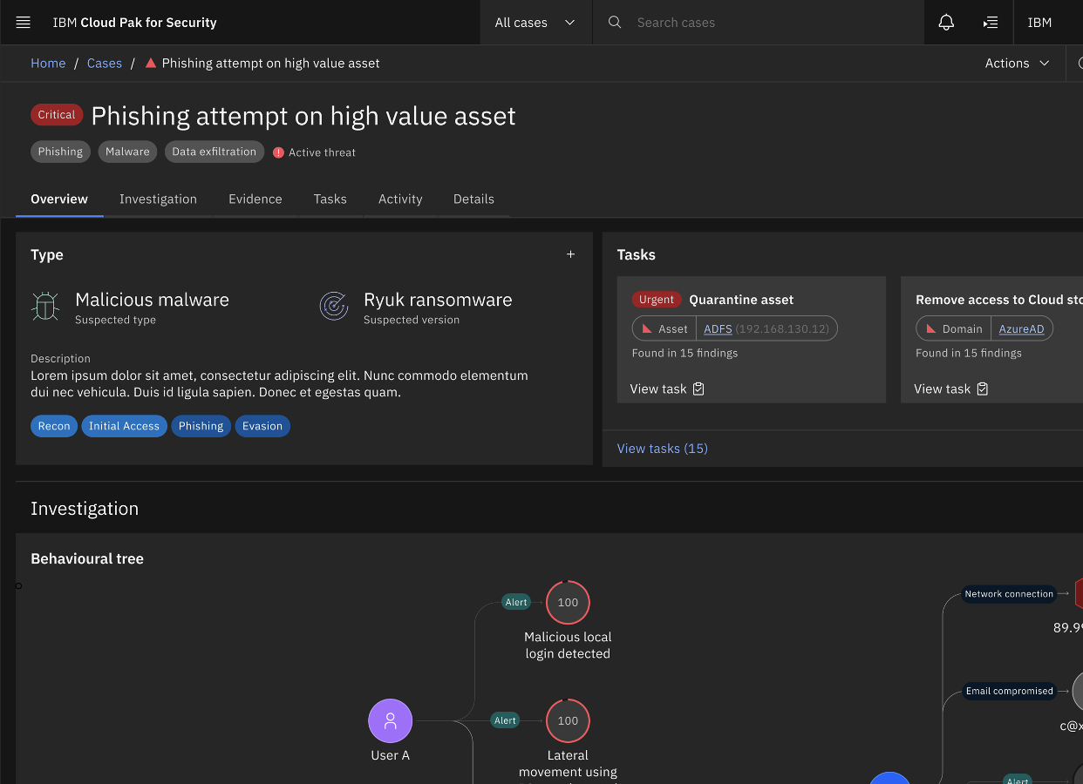
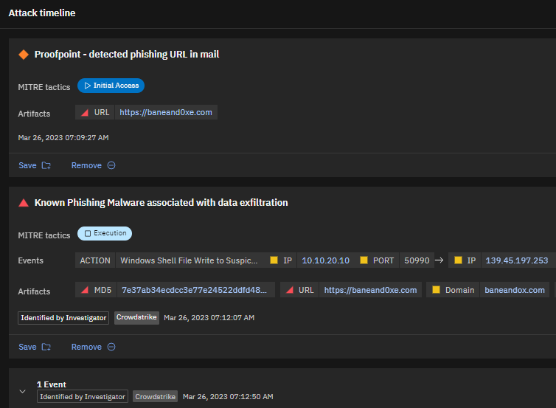
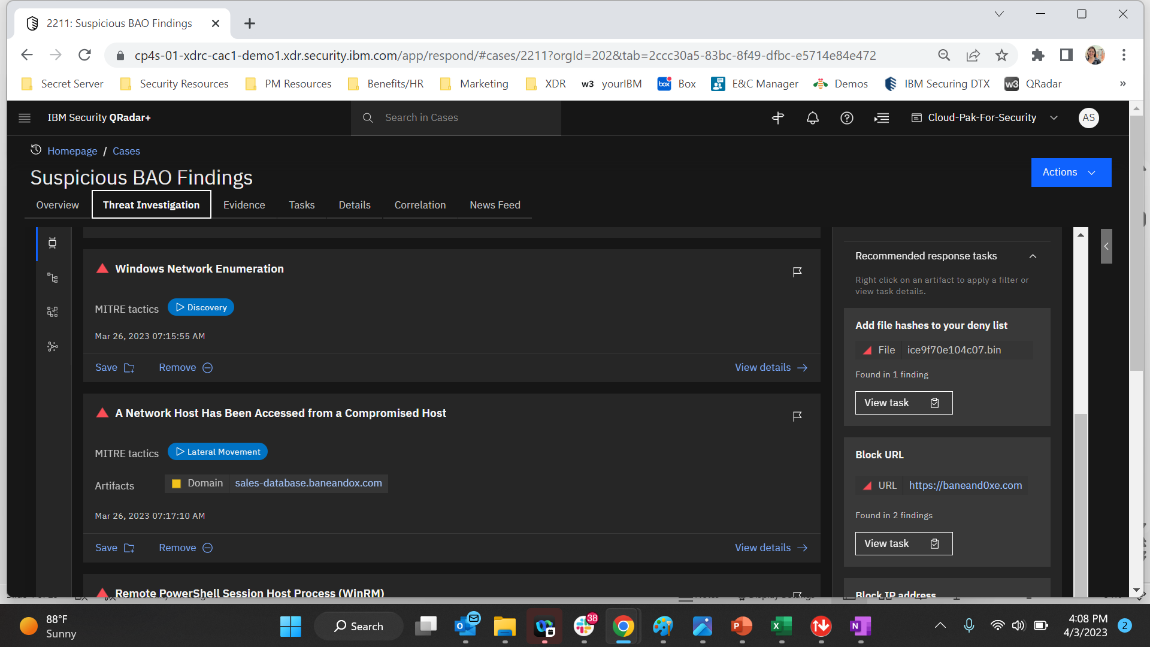
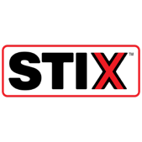

IBM QRadar XDR
Predict, prevent, and respond to modern threats
Go beyond the endpoint with OOTB integrations with cloud platform, SaaS, email, identity and data security systems
Act quickly with AI driven prioritization, automated investigations, integrated threat intelligence and hunting
Take action quickly with confidence with recommended actions and context
Take threat detection and response beyond the endpoint to include cloud, email, network, user and data into a a single correlated view to see and stop threats faster
Outcome
Powered by Open Standards and Source
OOTB detection, correlation, and enrichment
AI driven high-fidelity incidents
Improved team efficiency
8x faster investigations
Notes:
QRadar XDR coming soon

Slide 51
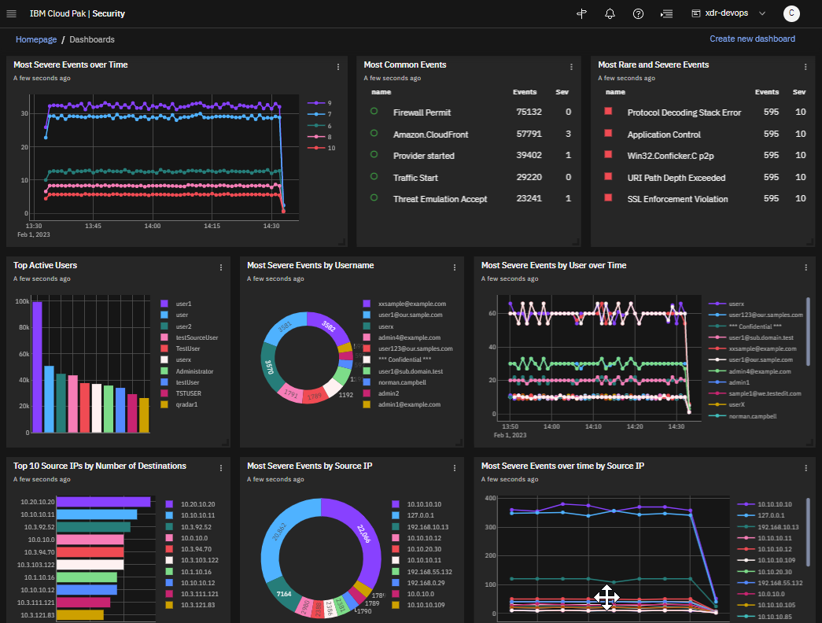
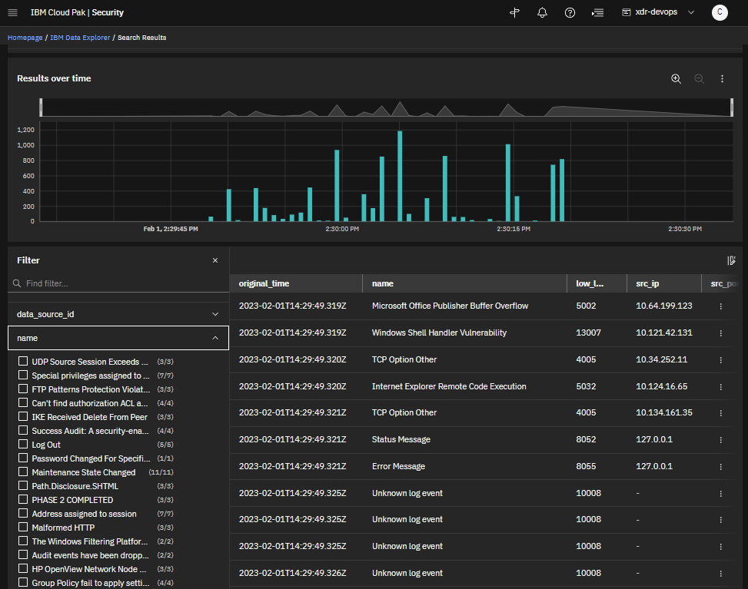
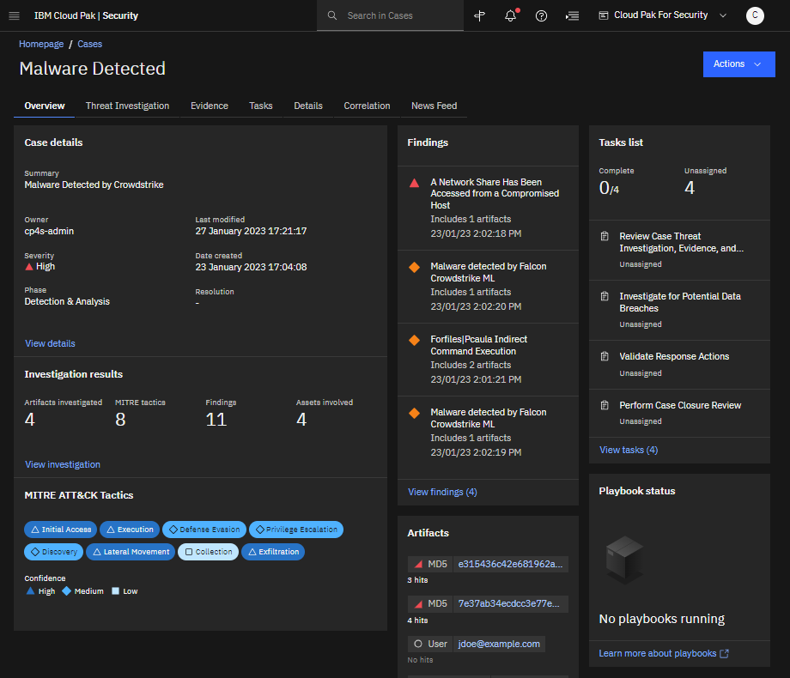




IBM QRadar Log Insights
Predict, prevent, and respond to modern threats
Real-time insights and quick setup
Gain enhanced security insights with improved visibility across data sources and repositories using hundreds of ready-made connectors
Fast investigation, fast answers
Leverage a modern, cloud-native data warehouse and intuitive query language, KQL, to easily handle large dataset queries in seconds
Performance at scale
Collaborate and leverage existing data stores with federated search and integrated case management
Gain complete visibility with cloud scale log ingestion, rapid search, powerful visualization and federated threat hunting and collaboration
Powered by Open Standards and Source
Open
Cybersecurity
Schema
Framework
Notes:
<Presenter: The intent of this slide is to introducing Log Insights for the first time, share the value and new use cases we support>
Intro
IBM is excited to introduce QRadar Log Insights – a cloud-native Log Management solution.
Log Insights was purpose built for customers who crave a unified enterprise logging solution with an aperature for security.
This includes a need for flexible retention options, elastic scalability, and solutions for basic threat analysis use cases.
Highlights
Log Insights delivers a unified enterprise logging solution with an aperature for security with:
A turn-key OOTB cloud services onboarding and automation
Event Ingestion at cloud scale with cloud elasticity to extract insights
Sub-second search results for large queries enabling real-time investigations
Automated data indexing with intuitive Visualizations for quick, at-a-glance insights
Flexible retention options for hot, warm and cold storage provided cost-competitive licensing and pricing metrics
For users who want near-real time search-based analytics, QRadar Log Insights provides for the capability for to be scheduled with as little as 30 seconds between repeated queries.
Transition
Now, let’s talk about the next offer in threat detection and analysis, QRadar SIEM, that incorporates correlation-based analytics.

Slide 52
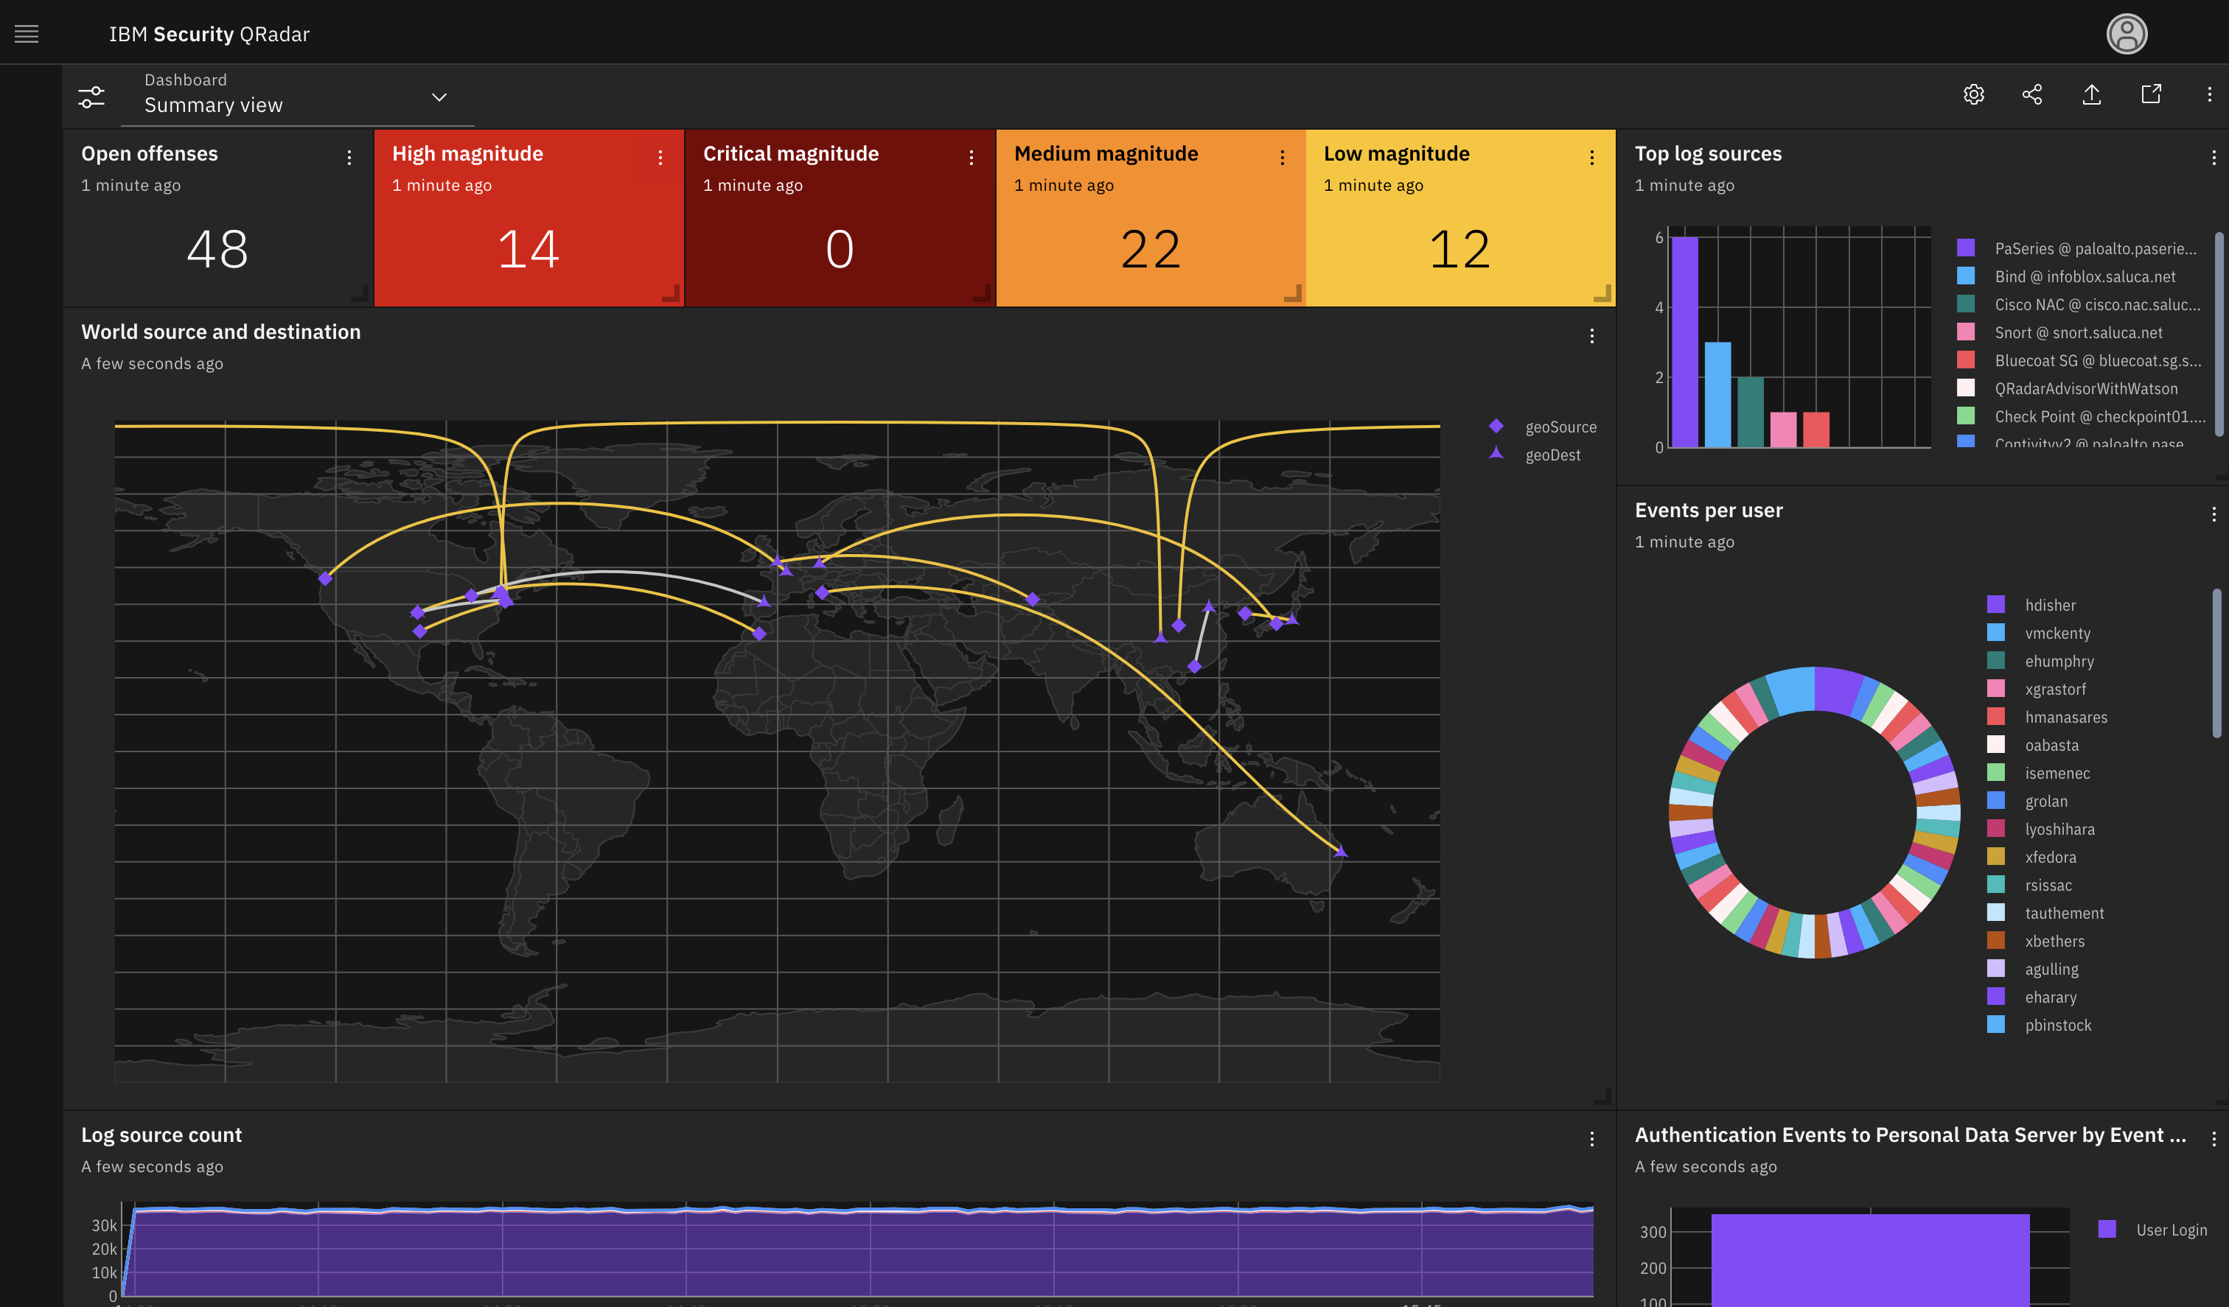
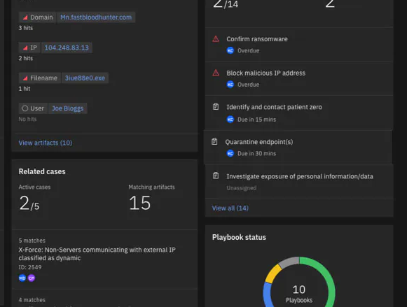





IBM QRadar SIEM
Predict, prevent, and respond to modern threats
Near real-time threat detection
Leverage AI to rapidly investigate and prioritize high fidelity alerts based on credibility, relevance, and severity of risk
Increased analyst productivity
A unified analyst experience, co-created with security experts, helps you act faster with added context and less screen switching
Simplified deployment and management with SaaS
Take the complexity and management out of running a SIEM associated with on-prem solutions
Run your business in the cloud and on-prem with visibility and security analytics built to stay ahead of advanced threats
354 Reviews – G2 Crowd
“IBM Security offers a solid base where we have 100% visibility and transparency, which helps us solve threats in a very short timeframe.”
- Klaus Glatz, CDO, Andritz
Powered by Open Security Standards
13x
SIEM Leader Gartner Magic Quadrant
11x
SIEM Leader G2
Open
Cybersecurity
Schema
Framework
ibm.com/case-studies/andritz/
Notes:
<Presenter: The intent of this slide is to introduce the QRadar SIEM solution, this is the solution that most prospective clients are familiar with so the focus is on the differentiators>
Intro
QRadar SIEM, is the industry standard for detecting advanced threats in the enterprise, with 15+ years of feature rich development.
Highlights
Real-time threat detection
Gives you complete visibility into your entire environment. It collects data from endpoints, network devices, cloud environments and even other data lakes
Then it applies advanced analytics with alert consolidation and risk prioritization to highlight your most critical threats.
QRadar SIEM (SaaS on AWS), will plug into the Unified Analyst Experience so clients who need the capabilities of QRadar SIEM will be able to begin leveraging the benefits of UAX capabilities immediately.
Increased analyst productivity
An AI, Expert System that will automatically investigate threats, with multi-stage analysis to accurately triage incidents faster
IBM's global threat intelligence, with automated threat hunting provides deep search capabilities so you can proactively hunt threats.

Slide 53
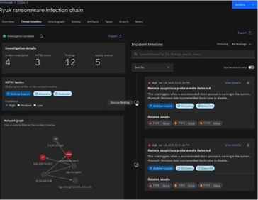

IBM QRadar SOAR
Predict, prevent, and respond to modern threats
Modern case management experience
Identify in a single pane the who, what, how, and actions taken on a security investigation and incident response
Reduce analyst
workload
Automated threat investigations and accelerated threat hunting
Streamline response with automation and intelligence
Respond x7 faster with dynamic playbooks that combine people, process and technology
Streamline your SOC with an automated and intelligent response using the industry’s most open and interoperable SOAR platform
300+
available integrations
180+ out-of-the-box templates for privacy regulations
85%
reduction in incident response time¹
¹ ibm.com/case-studies/doosan-digital-innovation
Notes:
<Presenter: The intent of this slide is to introduce SOAR, security orchestration automation and response>
Intro
Accelerate your response with QRadar SOAR, a market-leading security orchestration, automation, and response tool.
Highlights
Respond faster - bring in alerts from disparate data sources and work on a single dashboard for investigation and response.
Unify workflows - take a more holistic approach to case management - custom layout, adaptable playbooks, and tailored response. This facilitates getting started quicker, reduces complexity, and helps improve the incident response process.
Use AI and automation to bridge the skills gap - artifact correlation, investigation, and case prioritization is automated, even before someone touches the case. The playbook evolves as the investigation proceeds, with threat enrichment happening at each stage of the process.
Prepare for and respond to privacy breaches - integrate privacy reporting tasks into your overall incident response playbooks and work together with privacy, HR and legal teams to help address regulatory requirements with 180+ international privacy and data breach regulations built-in.
QRadar SOAR is a recent winner of a red dot user interface design award and aides in getting started quicker.
Manage costs and time with prebuilt integrations for a broad ecosystem of 300+ connectors (available and updated on AppExchange for hybrid cloud use cases), while helping your team respond more quickly and effectively, cutting response time by up to 85%.
Transition
We’ve talked about each of our QRadar products, now let’s talk about how you can amplify SOC efficiency with an integrated suite.

Slide 54



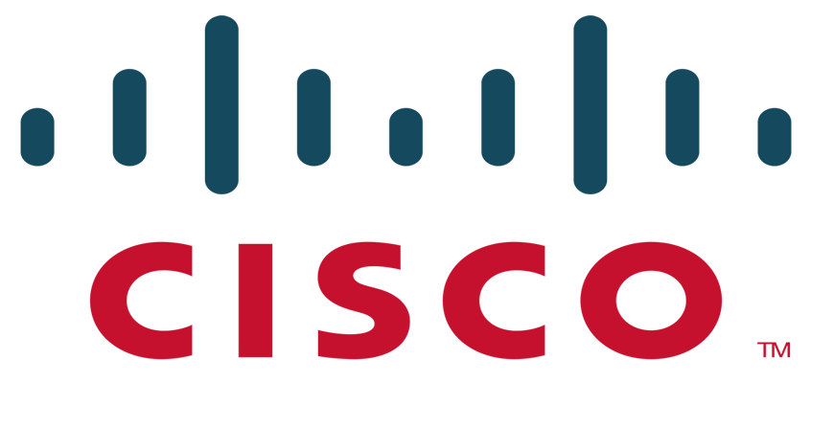
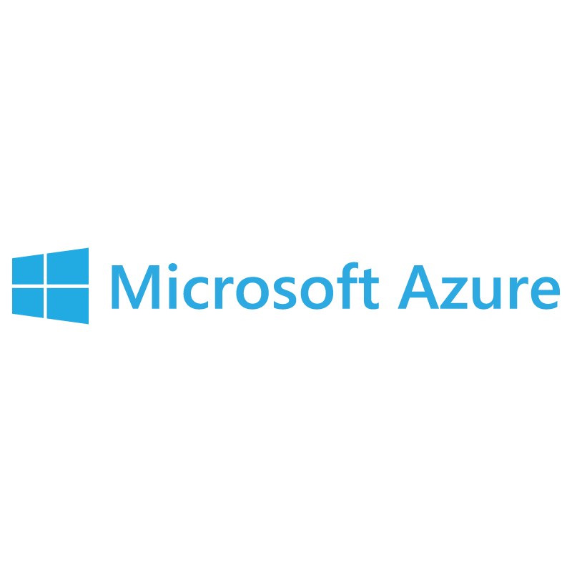



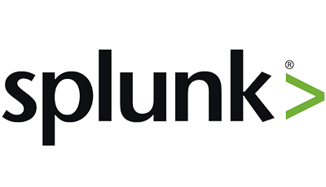



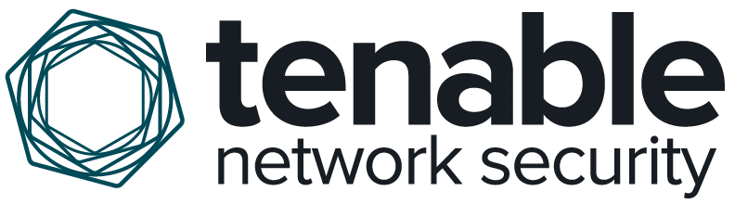













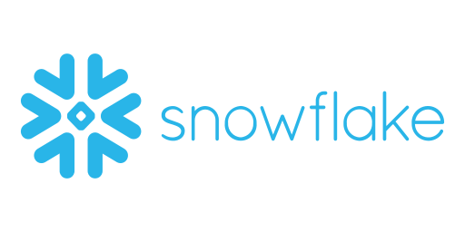







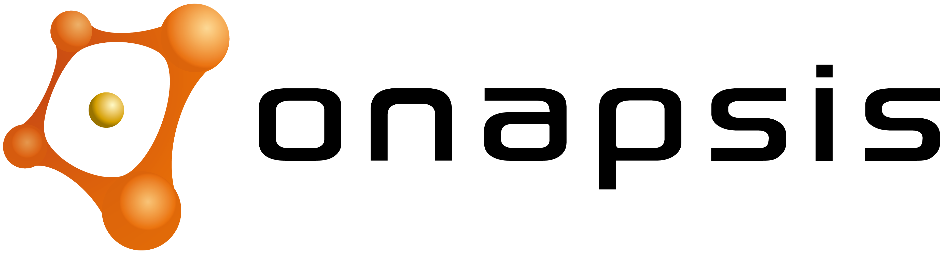






















Thousands of open integrations at the center of your ecosystem
…
…
Open source and open community
Open
Cybersecurity
Schema
Framework
Notes:
Because we believe security is a team sport, we’ve invested heavily on improving security solutions you already have by partnering with all sorts of security, cloud and SaaS vendors.
We have close to 200 members of our Technology Alliance Program (TAP) who’ve collaborated with us to build integrations and Apps on our products & platforms to make our products work better together for our mutual customers. Our TAP program is open to all technology companies, including companies we sometimes compete against, to make sure our solutions are performing well together.
We also have over 15 members of our Security Services Alliance program, who collaborate closely with IBM Security services on joint customer solutions.
There are many dimensions to Open. We’ve partnered with OASIS and other security companies and organizations to create the Open Cybersecurity Alliance (OCA), to improves interoperability of security technologies through open source code development, standards, and tooling that connects products across the entire security ecosystem. Two of these open source technologies contributed by IBM (STIX Shifter and Kestrel) are core to our QRadar XDR Connect product and Cloud Pak for Security platform. https://opencybersecurityalliance.org/
IBM has recently partnered with AWS, Splunk, and 17 other companies to launch and support the Open Cybersecurity Schema Framework (OCSF), an open specification for the normalization of security telemetry across a wide range of security products and services to simplify interoperability of security data.
https://aws.amazon.com/blogs/security/aws-co-announces-release-of-the-open-cybersecurity-schema-framework-ocsf-project/
https://community.ibm.com/community/user/security/blogs/dan-schofield/2022/08/10/ocsf-open-cybersecurity-framework/
We are also strong supporters of the MITRE Att&ck framework in our products, the Fido alliance authentication standards, and we are a proud founding sponsor of Quad9, a free, secure and private DNS service.
We have a steady stream of new integrations and collaborations through our open alliances and TAP program. Most notable include our strong collaboration with AWS and their native security capabilities across our portfolio, including:
AWS Security Competency certification for QRadar and Security Services, and integrations with 10 native AWS Security services and QRadar SIEM.
IBM was a launch partner at Re:Invent 2022 with AWS on their latest security innovations Amazon Security Lake and AWS Verified Access, as well as GuardDuty, Cloud Trails and many more.
We also have paid listings available in AWS Marketplace for QRadar, Guardium, Trusteer, and Verify, and an AWS QuickStart guide for CP4S.
Zscaler and IBM Security’s major new relationship around Zero Trust for IBM Security services and products. New integrated use case support for Zscaler’s Private Access product (zero trust network access) with QRadar and Verify, and Zscaler Internet Access with SOAR, QRadar, Verify, MaaS360.
Illumio is a leader in in network segmentation and delivers a suite of solutions that are purpose-built for Zero Trust security. The Illumio App for QRadar provides critical cloud and data center visibility to help security teams pinpoint potential attacks and identify compromised workloads. <And an upcoming integration with Cloud Pak for Security enables teams to orchestrate incident response across the most critical threats including ransomware.> The partnership between IBM Security and Illumio enables teams to achieve earlier detection and response while accelerating an organization’s Zero Trust journey.

Slide 55

Deliver the industry’s most Open Security Platform
Our Strategy
Predictive insights, enforcement, and open architecture to protect business across hybrid cloud
Global access to experts and delivery centers
AI-driven technology and automations across pillars of threat, data, and identity protection
Attacker’s perspective of assets and techniques
Open platform with common services for user experience and threat intelligence
Broadest ecosystem of integrations
Built for cloud with modern architecture, multi-cloud consumption model
Open Security Platform
Cybersecurity Consulting Services
Threat Detection and Response
Data
Security
Identity and Access Management
Common Platform – AI, Automation, Analytics, UX/UI
Global and Curated Threat Intelligence
Hybrid Multicloud Platform
Security Ecosystem
Security Vendors
Cloud Providers
SaaS Applications
Managed Security Providers
System Integrators
On premise
Hybrid Cloud
Multicloud
Notes:
[Presenter: This is an alternative architectural view of the security platform that visualizes how our key layers of investments work together --- services, technology, platform, ecosystem>
Our strategy is to provide an open and unified approach to security on a common platform of AI-driven technology.
Cloud Pak for Security, along with our consulting and managed services expertise, is designed to help clients:
Gain deeper security insights by connecting tools – whether IBM or 3rd party, and data – wherever it lives.
Respond faster to security incidents with AI and automation built-in.
And can run anywhere using a modern and modular approach to offer flexibility, extensibility, and avoid vendor lock-in.

Slide 56














The industry is on an Open Security Journey
Collective Defense
Shared cross-platform hunting
Shared cross-platform response runbooks
Linkage from intelligence to detection to response to policy enforcement
End-to-end collaboration
Collaborative Detection
Common frameworks to understand attackers
Common data models to enable analytics
Shared cross-platform detections
Threat Intelligence Sharing
Commercial and OSINT feeds
ISAC / ISAO sharing
Intelligence operationalization
Creation of organization-specific intelligence
Operational Standards and Compliance
Best practice consumption from regulators and industry bodies
Continuous policy monitoring and enforcement
Vulnerability normalization and prioritization
Foundational Standards
Foundational security elements
Encryption, identity, data interchange
Enable development of secure applications and services
Improved Risk Reduction
Collective Defense
Notes:
The industry is on an Open Security Journey
Foundational Standards
Foundational security elements
Encryption, identity, data interchange
Enable development of secure applications and services
Operational Standards and Compliance
Best practice consumption from regulators and industry bodies
Continuous policy monitoring and enforcement
Vulnerability normalization and prioritization
Threat Intelligence Sharing
Commercial and OSINT feeds
ISAC / ISAO sharing
Intelligence operationalization
Creation of organization-specific intelligence
Collaborative Detection
Common frameworks to understand attackers
Common data models to enable analytics
Shared cross-platform detections
Collective Defense
Shared cross-platform hunting
Shared cross-platform response runbooks
Linkage from intelligence to detection to response to policy enforcement
End-to-end collaboration

Slide 57


Proven leadership across 17 security segments
IBM Security competitive differentiation
Expert
services
Trusted Advisors
Cyber Ranges
Integrated Solutions
AI-infused technology
Threat Detection and Response
Data Security
Identity and Access
Managed Services
Open platform
IBM Cloud Pak for Security
Largest
ecosystem
Thousands of partner integrations
750K active users on X-Force Exchange
Notes:
[Presenter: End strong on “Why IBM?”, highlighting the key differentiators that make IBM unique in our ability to help clients mature their security program.]
Why IBM?
Because only IBM can combine thousands of experts, with the industry’s first Open security platform, AI-driven technology to reduce time and effort, and the largest security ecosystem in the world.
We’re recognized by independent industry analysts for our leadership and expertise as the world’s largest enterprise security products AND services provider.
Our proven industry leadership across 17 security segments is monumental evidence. <see speaker notes on “IBM Security at-a-glance” slide 5 for details> Many vendors work very hard to achieve leadership in just ONE domain, we’re fortunate to have the breadth of leadership across fifteen.
Our differentiation is made possible by the AI-driven and machine-learning technology which is infused across our entire portfolio.
Our open platform of Cloud Pak for Security is built on a foundation of Linux and Kubernetes which can run anywhere and offer a streamlined and connected way to implement Zero Trust.
We believe that cross-industry collaboration on common practices using open source code will enable best-of-breed security tools to freely exchange information for the greater good of our end users. This is the mission of the Open Cybersecurity Alliance, where we are helping to standardize the use of STIX-shifter for federated search, OpenDXL Ontology for consistent communication models, and Kestrel as the standard threat hunting language.
And because security is a team sport and building a zero trust strategy involves leveraging your existing and future investments... We have built one of the largest ecosystems in the world which includes:
Thousands of software integrations provided by IBM and our Alliance ecosystem partners, connecting our portfolio to security and cloud technologies that our customers rely on.
Technology and Service Alliances with leading security ISVs to collaborate on solutions via the IBM Security App Exchange -- our premier platform to deliver these apps and integrations.
We have 750,000 active users collaborating via X-Force Exchange where IBM openly shares data and customers collaborate on threats.
We’ve partnered with Quad 9 to help discover emerging threats and help protect users from those threats. Quad 9 is a secure privacy-focused free DNS service.
We’re proud of all of these examples, it’s what sets us apart from other vendors and it’s why we’re the trusted security advisor to thousands of clients around the world.

Slide 58













24 security acquisitions in 23 years
Proves our commitment to advance security innovation
1999 – 2010 acquisitions
2011
2013
2014
2015
2016
2017
2020
2021
2022
2023
Dascom and Access360 Identity management
Metamerge Directory integration
Datapower Technologies SOA management and security
Internet Security Systems Security services and network security
Watchfire Application security
Consul Risk management
Princeton Softech Data management
Encentuate Single-sign-on
Guardium Database monitoring and protection
OunceLabs Application security
BigFix Endpoint management and security
IBM Security Systems division is created
Advanced fraud protection and mobile security
IBM Security Systems and IBM Security Services merge to create a single business unit
IBM Security
Incident response and orchestration
Cloud security posture management
Attack surface management
an IBM Company
an IBM Company
Security intelligence
Cloud-enabled identity management, identity governance
Data-related
business risk
management
Endpoint detection and response
Automated cloud data protection
an IBM Company
an IBM Company
Notes:
For over 50 years, since the introduction of the mainframe, IBM has been committed to providing comprehensive security that meets evolving technological needs.
We have invested substantially in inorganic growth to supplement and enhance our organically developed security solutions to build a comprehensive portfolio that helps clients improve their security posture.
This progression was formalized in 2011 with the creation of the IBM Security Systems Division to help drive long-term strategic growth and value to our clients.
2011: IBM Security Systems division is created; IBM acquires Q1 Labs, with its QRadar security intelligence portfolio, to strengthen its offerings around advanced security analytics; IBM launches Cloud-based Mobile Security Services, IBM Hosted Mobile Device Security Management
2012: IBM delivers next-gen Intrusion system, new access appliance and privileged identity technology; IBM announces 25 new product releases in security, a record year of innovation; IBM extends its market leading static application security testing (IBM Security AppScan) to native Android applications, which allows clients to conduct their own testing for mobile applications; IBM acquires StoredIQ in a push for more big data capability.
2013: IBM announces breakthrough with combination of Security Intelligence and Big Data; IBM acquired CyberTap for their incident forensics technology; IBM announces new QRadar Vulnerability Manager software to help organizations identify and predict security risk; IBM announces MobileFirst security software (IBM AppScan Source 87 for iOS) to improve security quality without sacrificing time-to-market of mobile app projects; IBM announces acquiring Trusteer for mobile and application security, counter-fraud and malware detection; IBM announced acquiring Fiberlink’s MaaS360 offering expands IBM MobileFirst solutions with new cloud-based capabilities to deliver a comprehensive mobile management and security solution for global organizations of all sizes. This acquisition supports IBM’s expanding vision for enterprise mobility management, which encompasses secure transactions between businesses, partners and customers.
2014: IBM announces the acquisition of Lighthouse Security Group a cloud security services provider; IBM acquires CrossIdeas an innovative provider of identity governance and analytics software.
2015: In an IBM reorganization, IBM Security Systems Division advances to become an IBM business unit called IBM Security.
2016: IBM Security acquires Resilient Systems in April of 2016 and will be part of a significant expansion of the company's capabilities in the incident response marketplace. Resilient’s technology automates and orchestrates the many processes needed when dealing with cyber incidents - from breaches to lost devices.
2017: IBM acquires Agile 3 Solutions in Feb. 2017 . The software is used by the C-Suite to better visualize, understand and manage risks associated with the protection of sensitive data. The company joins the IBM Security business unit and will be part of the IBM Data Security Services portfolio of offerings. The acquisition also builds on the growth of IBM's end-to-end Guardium data security and protection platform, which helps to analyze the risk associated with sensitive data, monitor and protect sensitive data at rest, and in motion. IBM and Cisco form partnership in May of 2017. IBM and Cisco, the two largest enterprise security companies in the world, for partnership to integrate solutions and share intelligence to better protect organizations across networks and in the cloud.
2020: IBM acquires Spanugo, a cloud security posture management company to further delivery of secure, compliance-ready and industry-specific public cloud capabilities to clients in highly regulated industries.
2021: IBM acquires ReaQta, an endpoint security company to further differentiate the portfolio of connected, open security tools to unify and speed response to security threats. ReaQta's behavioral-based platform helps stop known and unknown threats in real-time and can be deployed in a hybrid model – on premise or in the cloud as well as air gapped environments.
2022: IBM acquires Randori, an attack surface management company to further simplify threat detection and response, building on recent acquisition of ReaQta and Launch of QRadar XDR. It adds automation and skills to IBM X-Force's elite offensive cybersecurity team while bringing attackers' point-of-view into security operation center.
2023: IBM has acquired Polar Security, an innovator in technology that helps companies discover, continuously monitor and secure cloud and software-as-a-service (SaaS) application data – and addresses the growing shadow data problem.
______ More historic details:
1976: IBM introduces Resource Access Control Facility (RACF), to provides access control and auditing functionality for applications on the mainframe eliminating the need for each application to imbed security
1977: The IBM develops Data Encryption Standard (DES), a cryptographic algorithm, adopted as the national standard by the US National Bureau of Standards
1978: IBM announces the 3624 automatic teller machine, utilizing DES
1995: IBM starts contributing to Java Security technologies
1996: IBM launches Cryptolope containers to seal intellectual property in a digital package so that content transactions are secured over the Internet; IBM launches the SecureWay Key Management Framework, a collection of applications, services and cryptographic engines that help make the Internet safe for e-commerce; IBM begins pilot program with MasterCard using Secure Electronic Transaction (SET) technology which secures credit card transactions over the Internet; IBM develops and certifies the IBM Secure Crypto Co-processor (4758) at FIPS 104-1 Level 4, the highest level of FIPS; IBM releases its first enterprise-grade LDAP Directory Server (now known as Directory Server)
1998: IBM extends Secure Electronic Transaction (SET) standard support which secures payments over the Internet and is largely based on technology developed at IBM Research and adopted by major credit card companies.
1999: IBM acquires Dascom, the basis for IBM's Access Manager portfolio; IBM Research's breakthrough paper on Side Channel Cryptanalysis Attacks and Countermeasures (1999 – 2004)
2000: IBM patents a system and method for alerting computer users to digital security intrusions; IBM appoints Harriet Pearson its first Chief Privacy Officer.
2002: IBM acquires Access 360, the basis for IBM's Identity Manager portfolio; IBM acquires MetaMerge for meta-directory and directory synch capability (now known as Directory Integrator)
2005: IBM acquires Datapower Technology an SOA hardware appliance vendor ; IBM debuts the first ThinkPad with an integrated fingerprint reader, at the time offering an unmatched level of data protection through a new biometric capability and embedded security subsystem
2006: IBM acquires Internet Security Systems, Inc, the basis for today’s IBM X-Force® IT security research team and the IBM network protection product family; Smart cards, highly efficient JavaCard™ technology developed at IBM Research - the technology is used today in 10s of millions of VISA credit cards today.
2007: IBM acquires Watchfire, makers of the AppScan web security scanning tool; IBM acquires Consul to help accelerate data and governance strategy; IBM acquires Princeton Softech for its data management capabilities.
2008: IBM acquires Encentuate, the basis for 'IBMs Enterprise Single-sign-on (ESSO) product; IBM patents a secure system and method for enforcement of privacy policy and protection of confidentiality; Zone Trusted Information Channel plugs into the USB port of any computer and creates a direct, secure channel to a bank’s online transaction server, bypassing the PC which could be infected by malicious software (malware) or susceptible to hacker attacks
2009: IBM acquires Guardium, a market leader in real-time enterprise database monitoring and protection; IBM acquires Ounce Labs, a provider of software that analyzes software code for security vulnerabilities, today’s AppScan family; IBM pioneers the use of Big Data analytics to cybersecurity problems (FAA, USAF).
2010: IBM acquires Big Fix to help organizations extend security and compliance to their endpoints.

Slide 59

Leverage a global network of protection and training
Global Security Expertise
Command Centers
Solution Development
Security Research
Notes:
IBM knows security is not just about technology. We believe it takes incredible people and proven process. That’s why we operate the broadest enterprise security research, development, and delivery organizations in the world.
We’ve invested in employing and influencing some of the brightest minds in the industry. In fact, our incidence response team is comprised of ex-military luminaries and white-hat hackers – all ready to help when you need it most. This combined global expertise includes the award-winning IBM X-Force Team — which maintains one of the largest vulnerability databases in the industry (1 trillion events per month)
We also have 10 X-Force Command Centers which include Executive Briefing Centers where you can meet with experienced incident responders, penetration testers, design thinking experts, and IBM executives to build and hone your cybersecurity and incident response strategy.
We also have 13 global Security Solution Development Centers where developers work on state-of-the-art security solutions.
And 10 Security Research Centers where considerable mass of our employee’s work; as well as the IBM Research Labs that focus on Cybersecurity and topic-specific research.
LIST OF LOCATIONS:
(10) X-Force Command Centers (and executive briefing centers):
Cambridge, MA
Boulder, Colorado
Atlanta, GA
Heredia, Costa Rica
Hortolandia, Sao Paulo, Brazil
Brussels, Belgium
Wroclaw, Poland
Tokyo, Japan
Bangalore, India
Riyadh, Saudi Arabia
(13) Security Solution Development Centers:
Fredericton, New Brunswick, Canada
Austin, TX, USA
Raleigh, NC, USA
Belfast, N Ireland
Delft, NL
Krakow, Poland
Rome, Italy
Bangalore, IN
Taipei, TW
Hakozaki, Tokyo, Japan
Singapore, SG
Gold Coast, AU
Perth, AU
(10) Security Research Centers:
Almaden, CA
Atlanta, GA
Austin, TX
Yorktown Heights, NY (TJ Watson)
Dublin, Ireland
Kassel, Germany
Zurich, Switzerland
Haifa, Israel
Beer Sheva, Israel
Herzliya, Israel
Learn more about The IBM X-Force Special Forces Team of Experts: https://www.ibm.com/security/services/xforce-command-special-forces-team

Slide 60

Ready for future battles
Over 200 security researchers working hard to deliver security innovations that move with your business
Enforce zero-trust controls
Provide continuous compliance and digital sovereignty across decentralized environments using full-stack zero trust architectures
Secure the supply chain
Protect hybrid cloud deployments with cloud-native secure software supply chain and 3rd party services
Counter advanced threats
Protect against advanced attacks with quantum-safe cryptography, fully homomorphic encryption, and robust AI
Build trusted systems
Protect hardware using chiplet security and cloud-native secure Exploratory Data Analysis (EDA)
Notes:
IBM Security Research team’s mission is to create industry-leading security innovations to help security move with your business of today and tomorrow.
<IBMer: See The Forge for more information: https://w3.ibm.com/w3publisher/security-forge/build/incubation/ibm-research>

Slide 61




IBM Security solutions to address today’s challenges
Predict, prevent, and respond to modern threats
IBM Security QRadar Suite
IBM Randori Recon
IBM QRadar EDR
IBM QRadar XDR
IBM Security Threat Management Services
IBM X-Force Red
IBM X-Force Incident Response Retainer
IBM X-Force Threat Intelligence
IBM X-Force Cyber Range Experiences
Centralize data security and compliance
IBM Security Guardium
IBM Z Security
IBM Data and Application Security Services
Authenticate users and manage employee devices
IBM Security Verify
IBM Security MaaS360
IBM Security Trusteer
IBM Security IAM Services
IBM SASE Services Powered by IBM Technology Alliances
IBM Zero Trust Acceleration Services
Execute a cybersecurity strategy and roadmap
IBM Security Consulting Services
IBM Security Expert Labs
IBM Managed Security Services
IBM QRadar Log Insights
IBM QRadar SIEM
IBM differentiation
Deep expertise
Trusted Advisors
IBM X-Force Cyber Range Experiences
Integrated Solutions
Open delivery platform
IBM Cloud Pak for Security
AI-driven technology
Threat Detection and Response
Data Security
Identity and Access
Managed Services
Largest ecosystem
Thousands of partner integrations
750K active users on IBM X-Force Exchange
Accelerate security with an open architecture, AI and intelligence
Integrate existing security tools and save time with a hybrid cloud platform powered by AI, global intelligence, and open integrations
Notes:
[Presenter: This is intended as an internal reference slide to show the breadth of our solutions across use cases.]

